Slide 1
Irrigate all the things!
Matt Virus / @themattvirus
www.hackspace.io
@hackspaceio

Slide 2
Table of contents
01
02
03
04
Why waste time doing this?
Water… Everywhere
Because reasons, that’s why.
Pieces and parts to get water where it’s needed. Yes, a butane torch is necessary.
Hackery.
What’s next?
No cloud, no way. Flash firmware and connect things up.
Because scope creep is required.

Slide 3
01
Why waste time doing this?
Making stuff grow just means more work to do later, doesn’t it?

Slide 4
Irrigation? Meh….
Large porch -> many plants
Garden too, yay!
Plants and garden stuff is expensive
Kids + life + work = forget to water
Forget to water → dead plants and flowers
RE-planting and replacing dead flowers is expensive and time consuming
Watering grass/pastures is too easy to forget

Slide 5
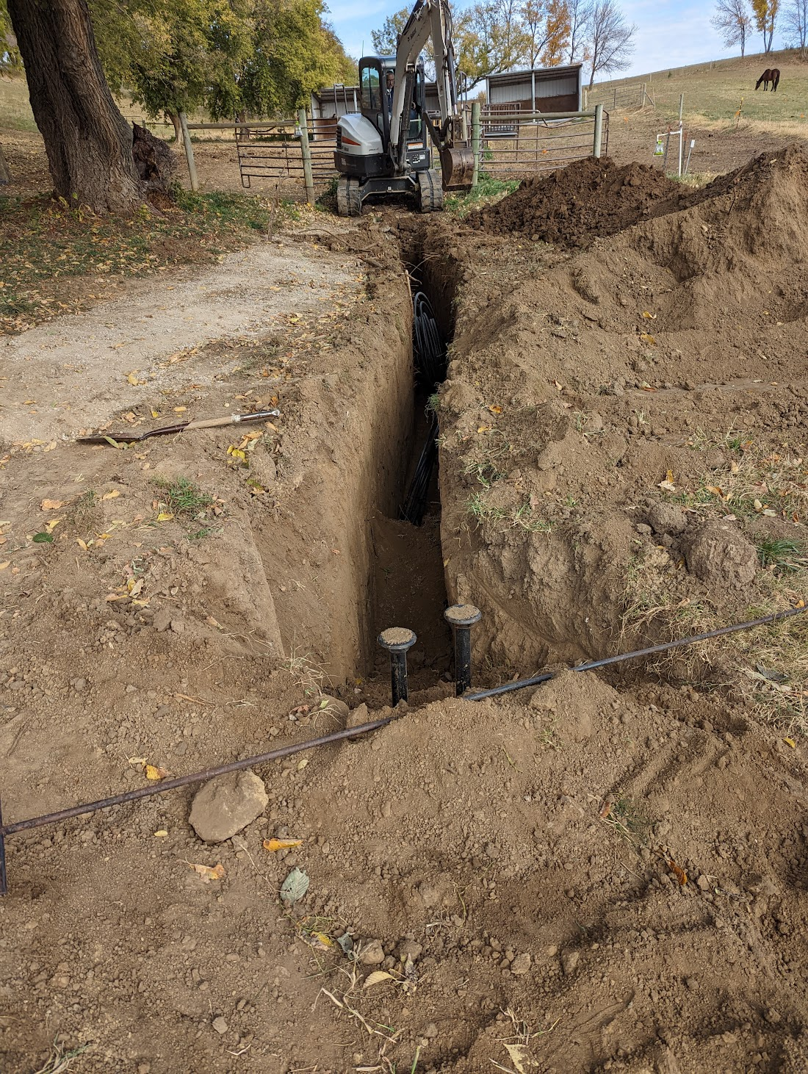
Irrigation? Meh….
Large-scale projects leave lots of grass renovation requirements
Regular watering at multiple locations is an extremely time-consuming problem for manual operation

Slide 6
02
Water… Everywhere
H20 Distribution Engineering

Slide 7
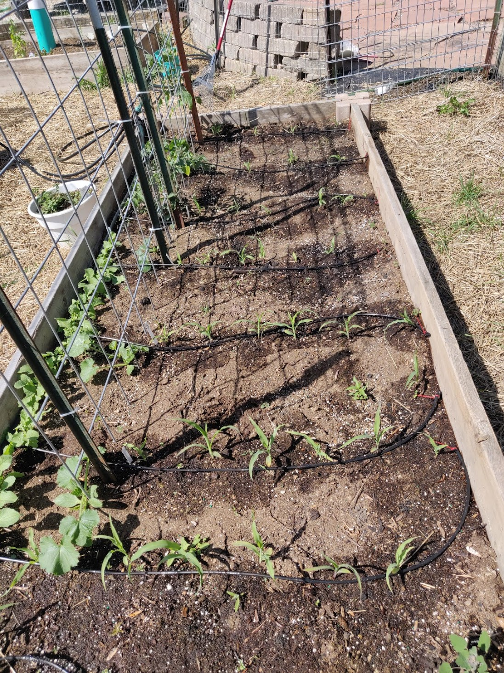
Water Distribution
Garden:
½” pipe main runs
¼” pipe drip irrigation
¼” hose to emitters
Hanging Plants
¾” PVC pipe around edge of porch
¼” hose to emitters in each hanging plant
¼” and ½” hose to feed porch/landscape plants
Pasture / Grass
Basic garden hose
Steel T-Post sprinklers
Use what you have!
Be mindful of distance/volume/pressure
Butane torch works GREAT to heat up/soften hoses
Careful not to burn/damage – just heat and soften
Especially good for working with ¼” tubing

Slide 8
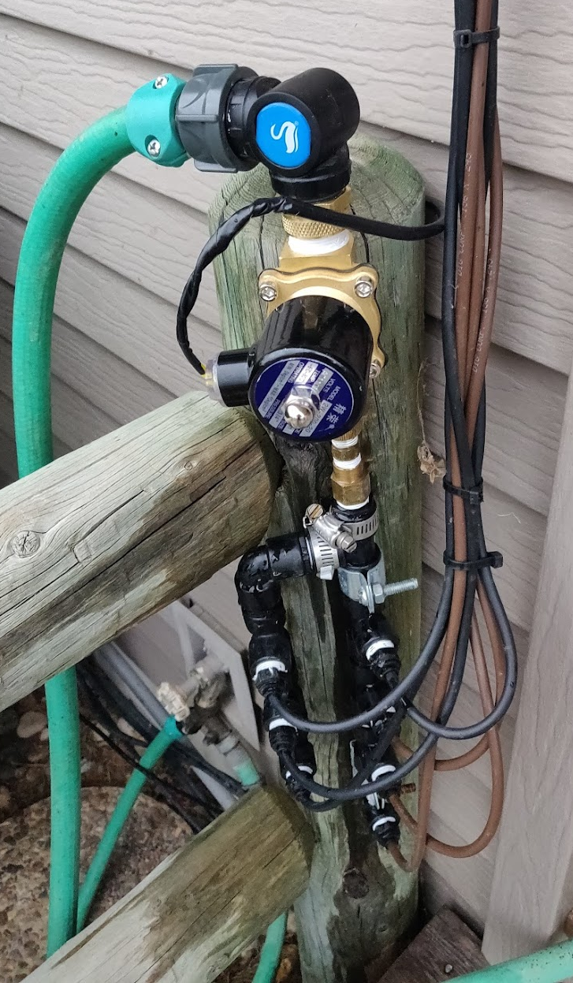
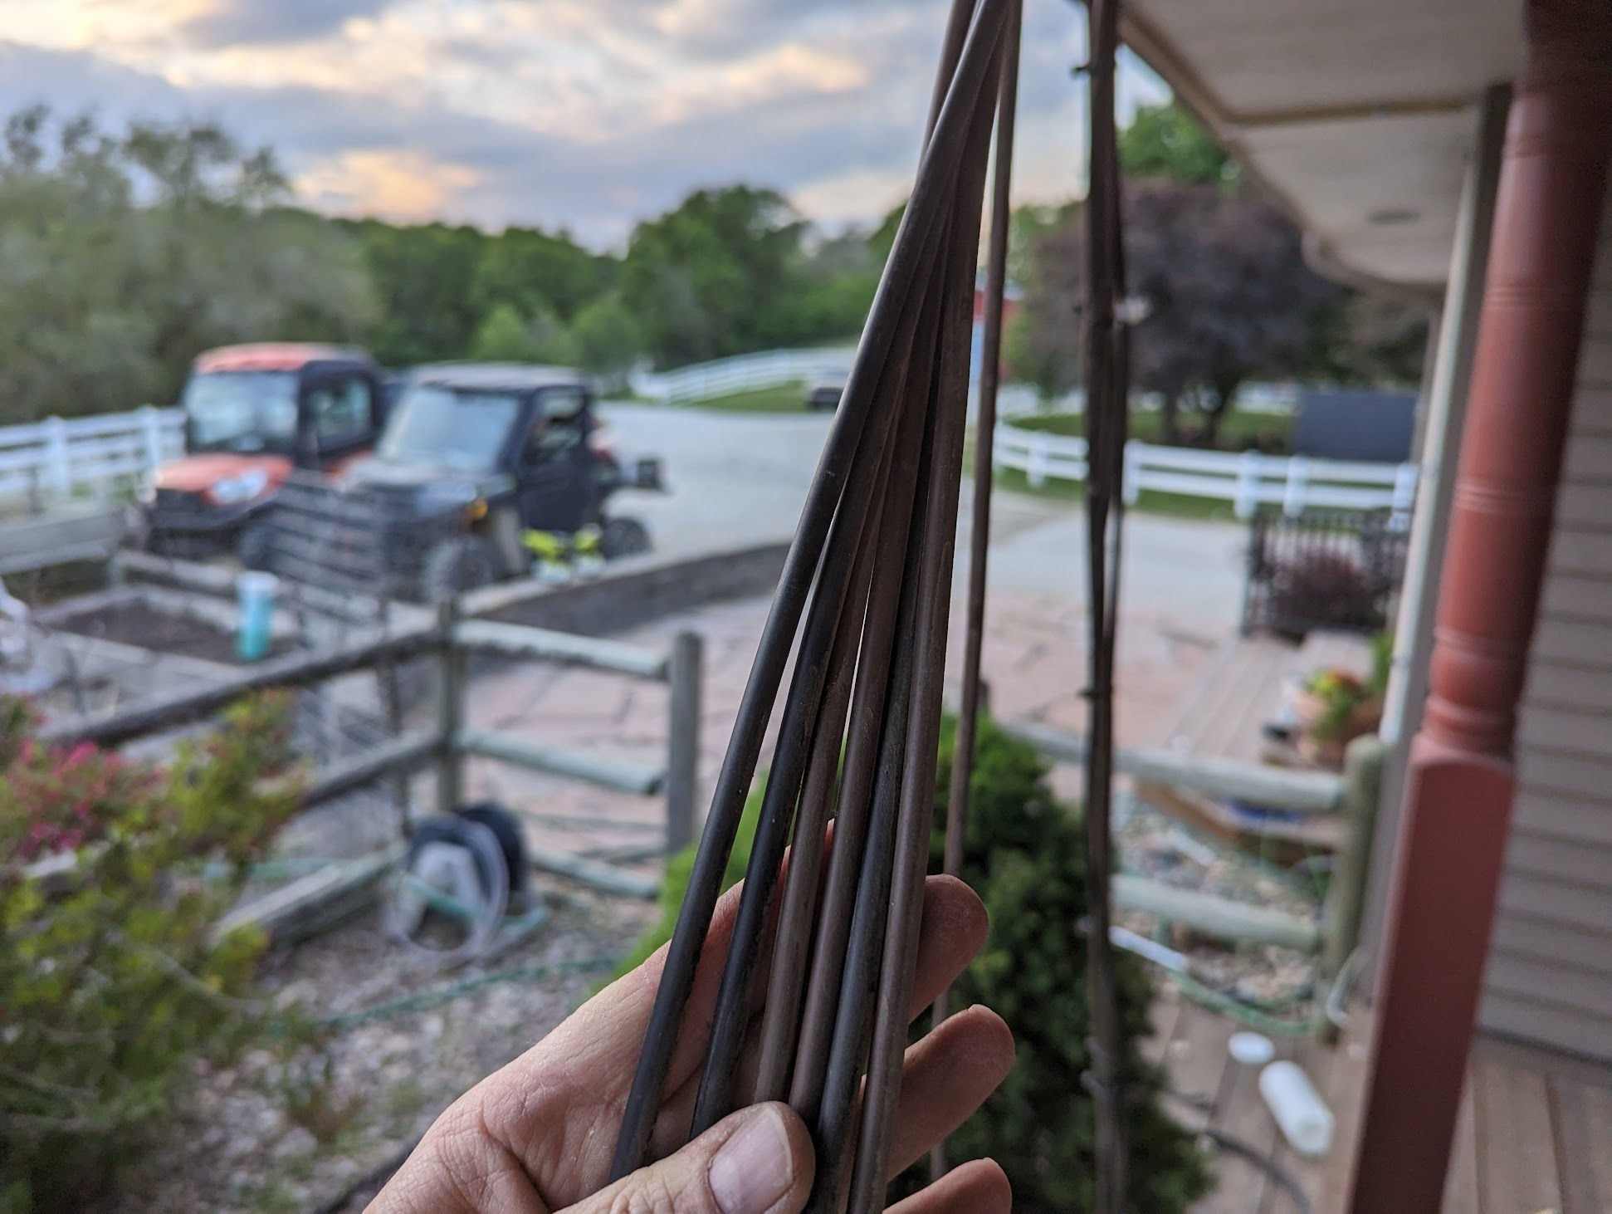
Manifold Challenges → Removal!
Original setup used a dedicated ¼” run to (basically) every plant.
Thought this would make for more even watering and balance things out
Worked OK, but…
Lots of connectors
Lots of leaks
The high number of connections and the pressure regulation at the head end of the system effectively reduced pressure everywhere
Better to have unrestricted inflow, and only restrict outflow
Hence, move to ¾” PVC distribution and reduction to ¼” only at outlet

Slide 9
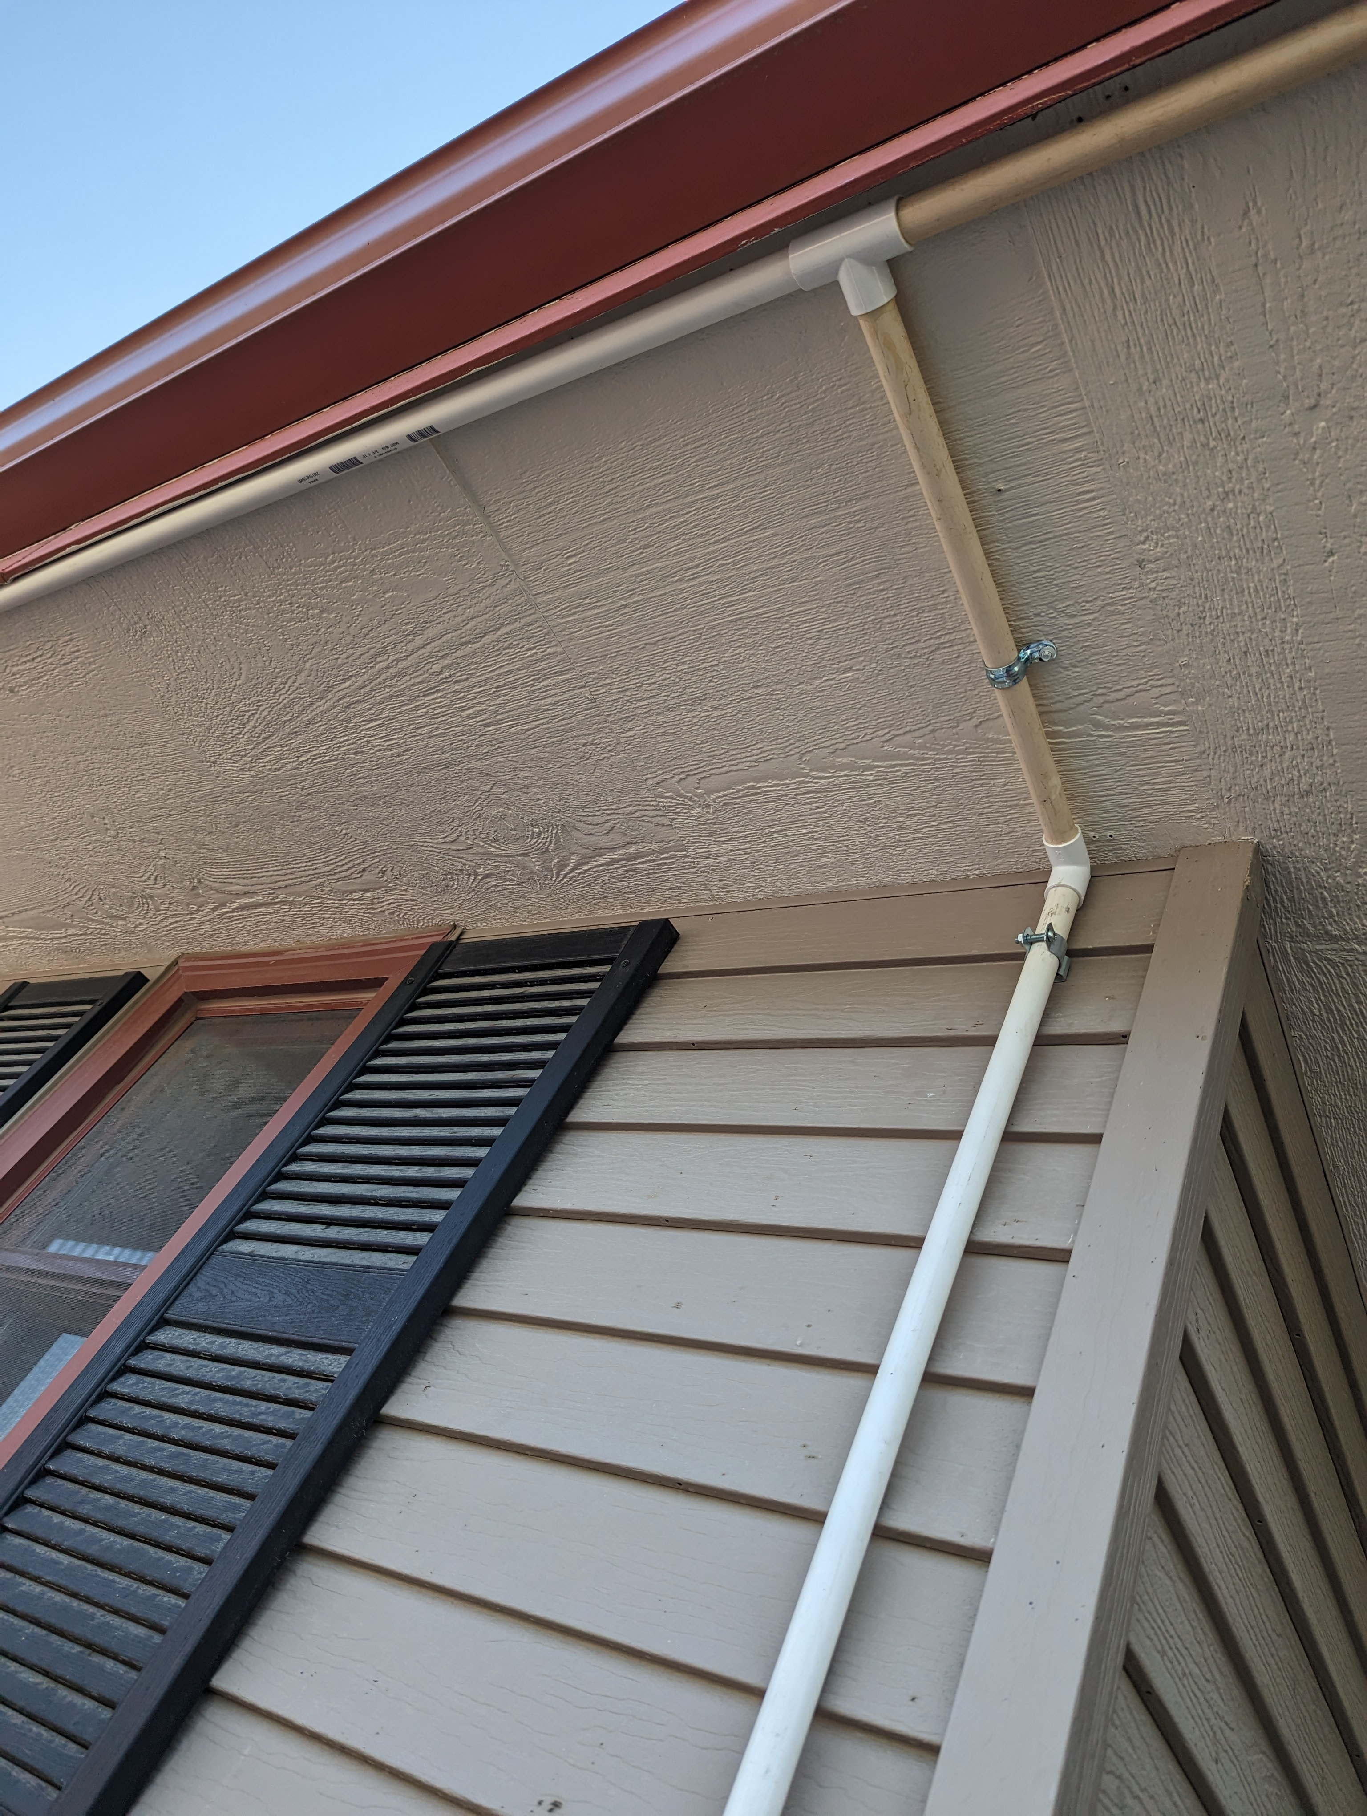
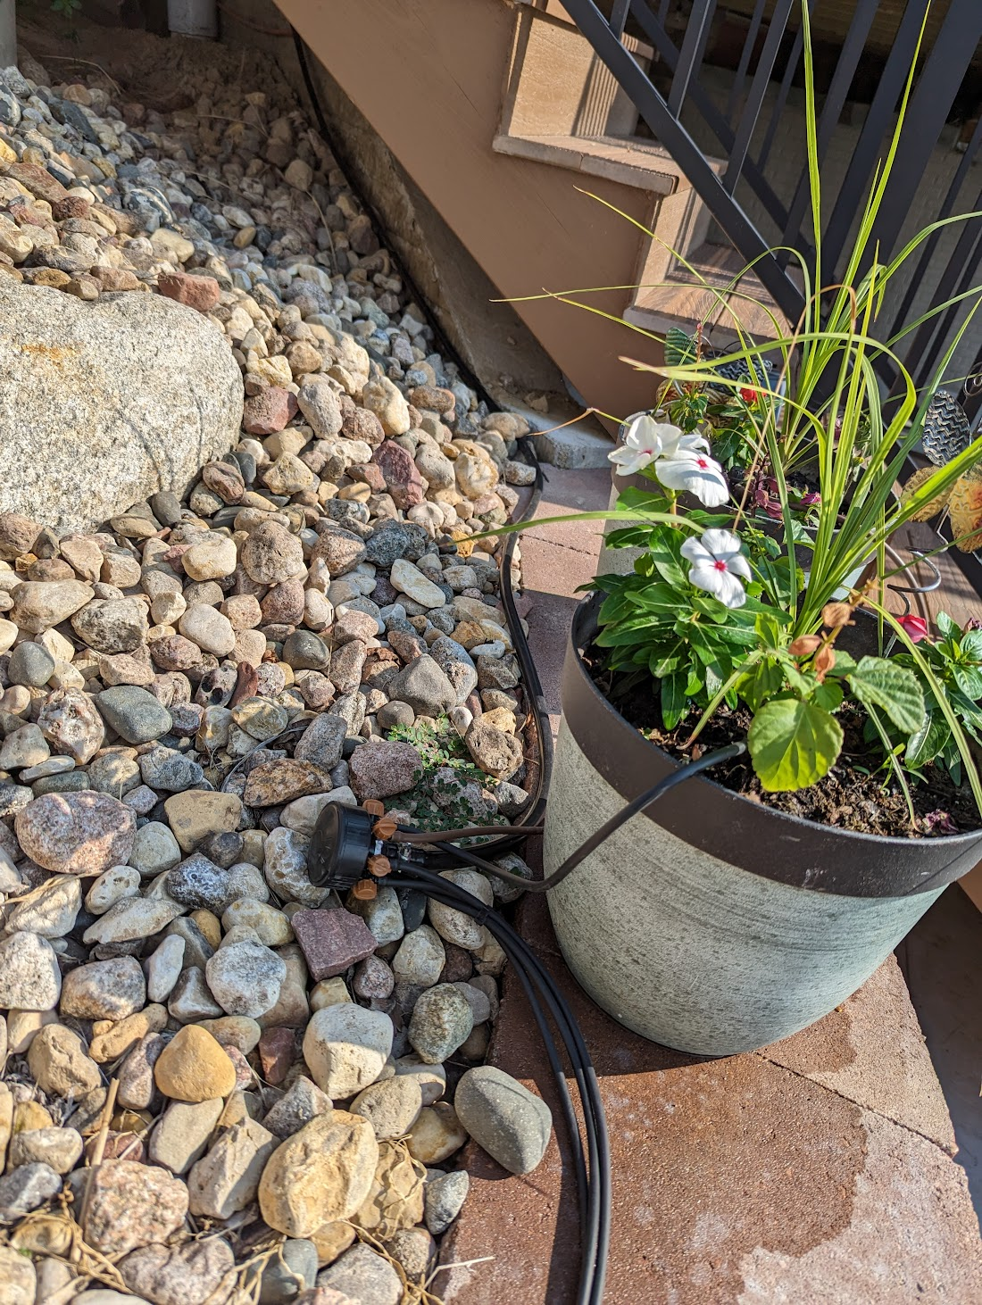
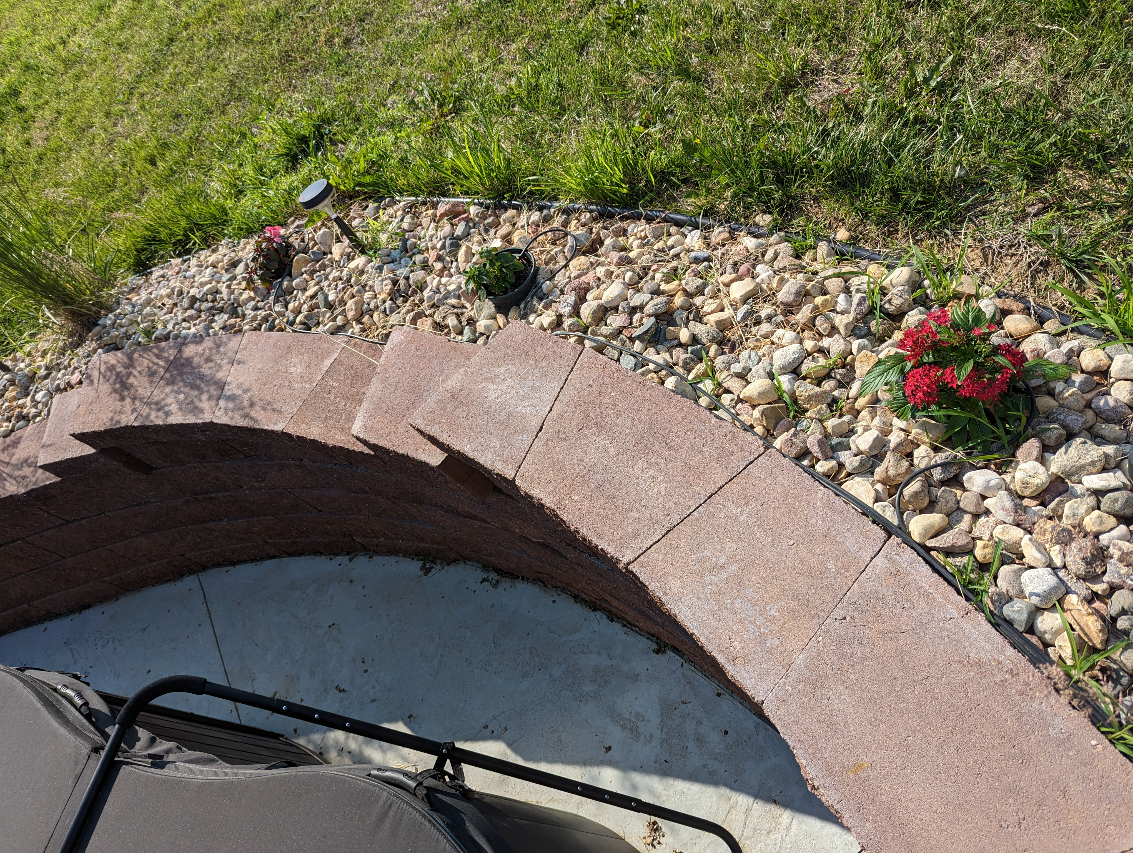
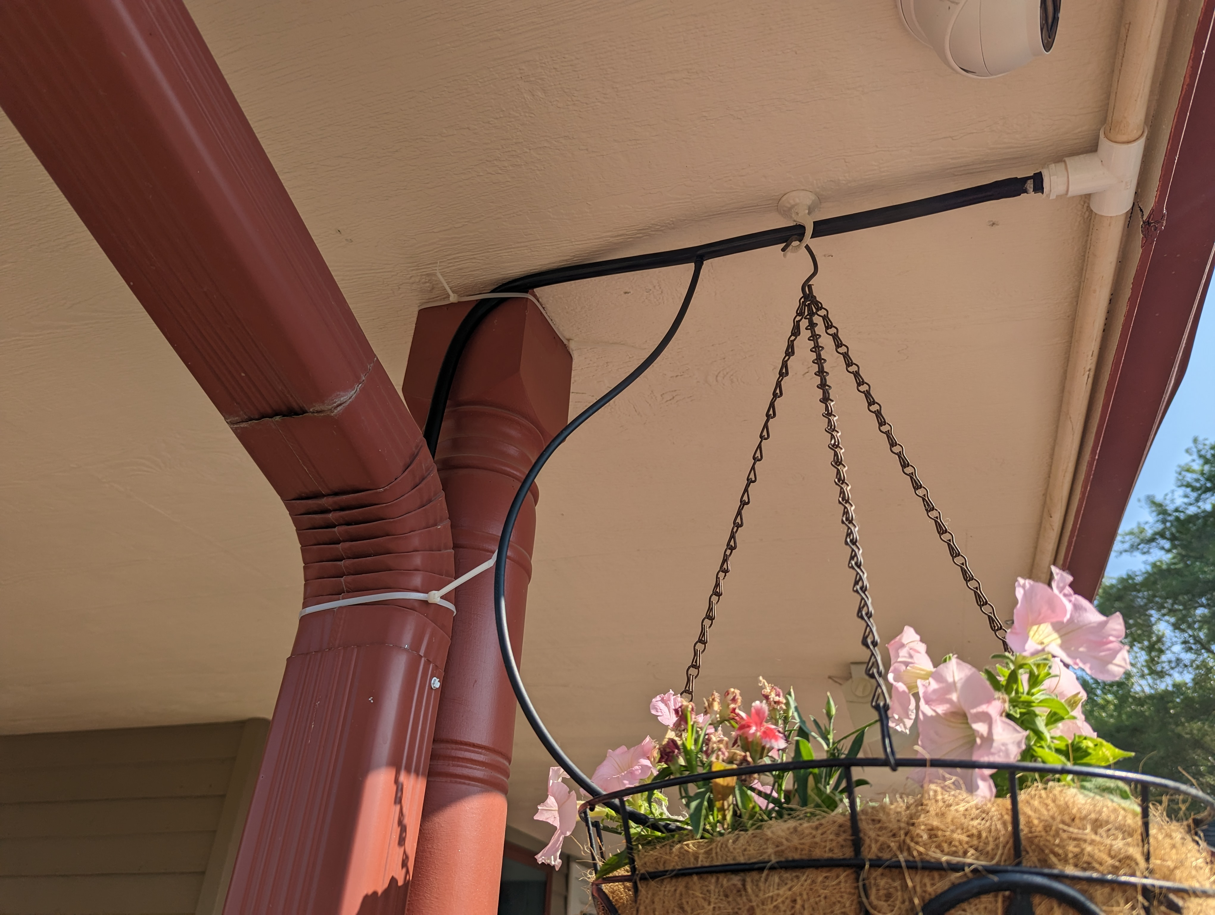
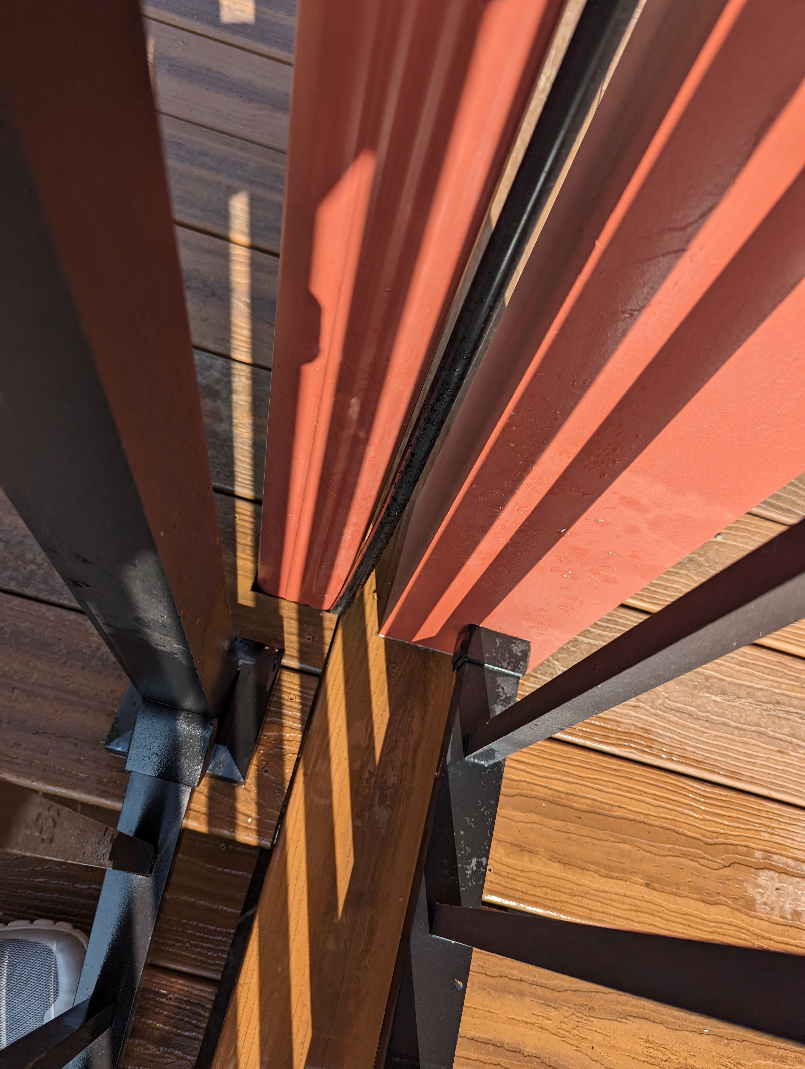
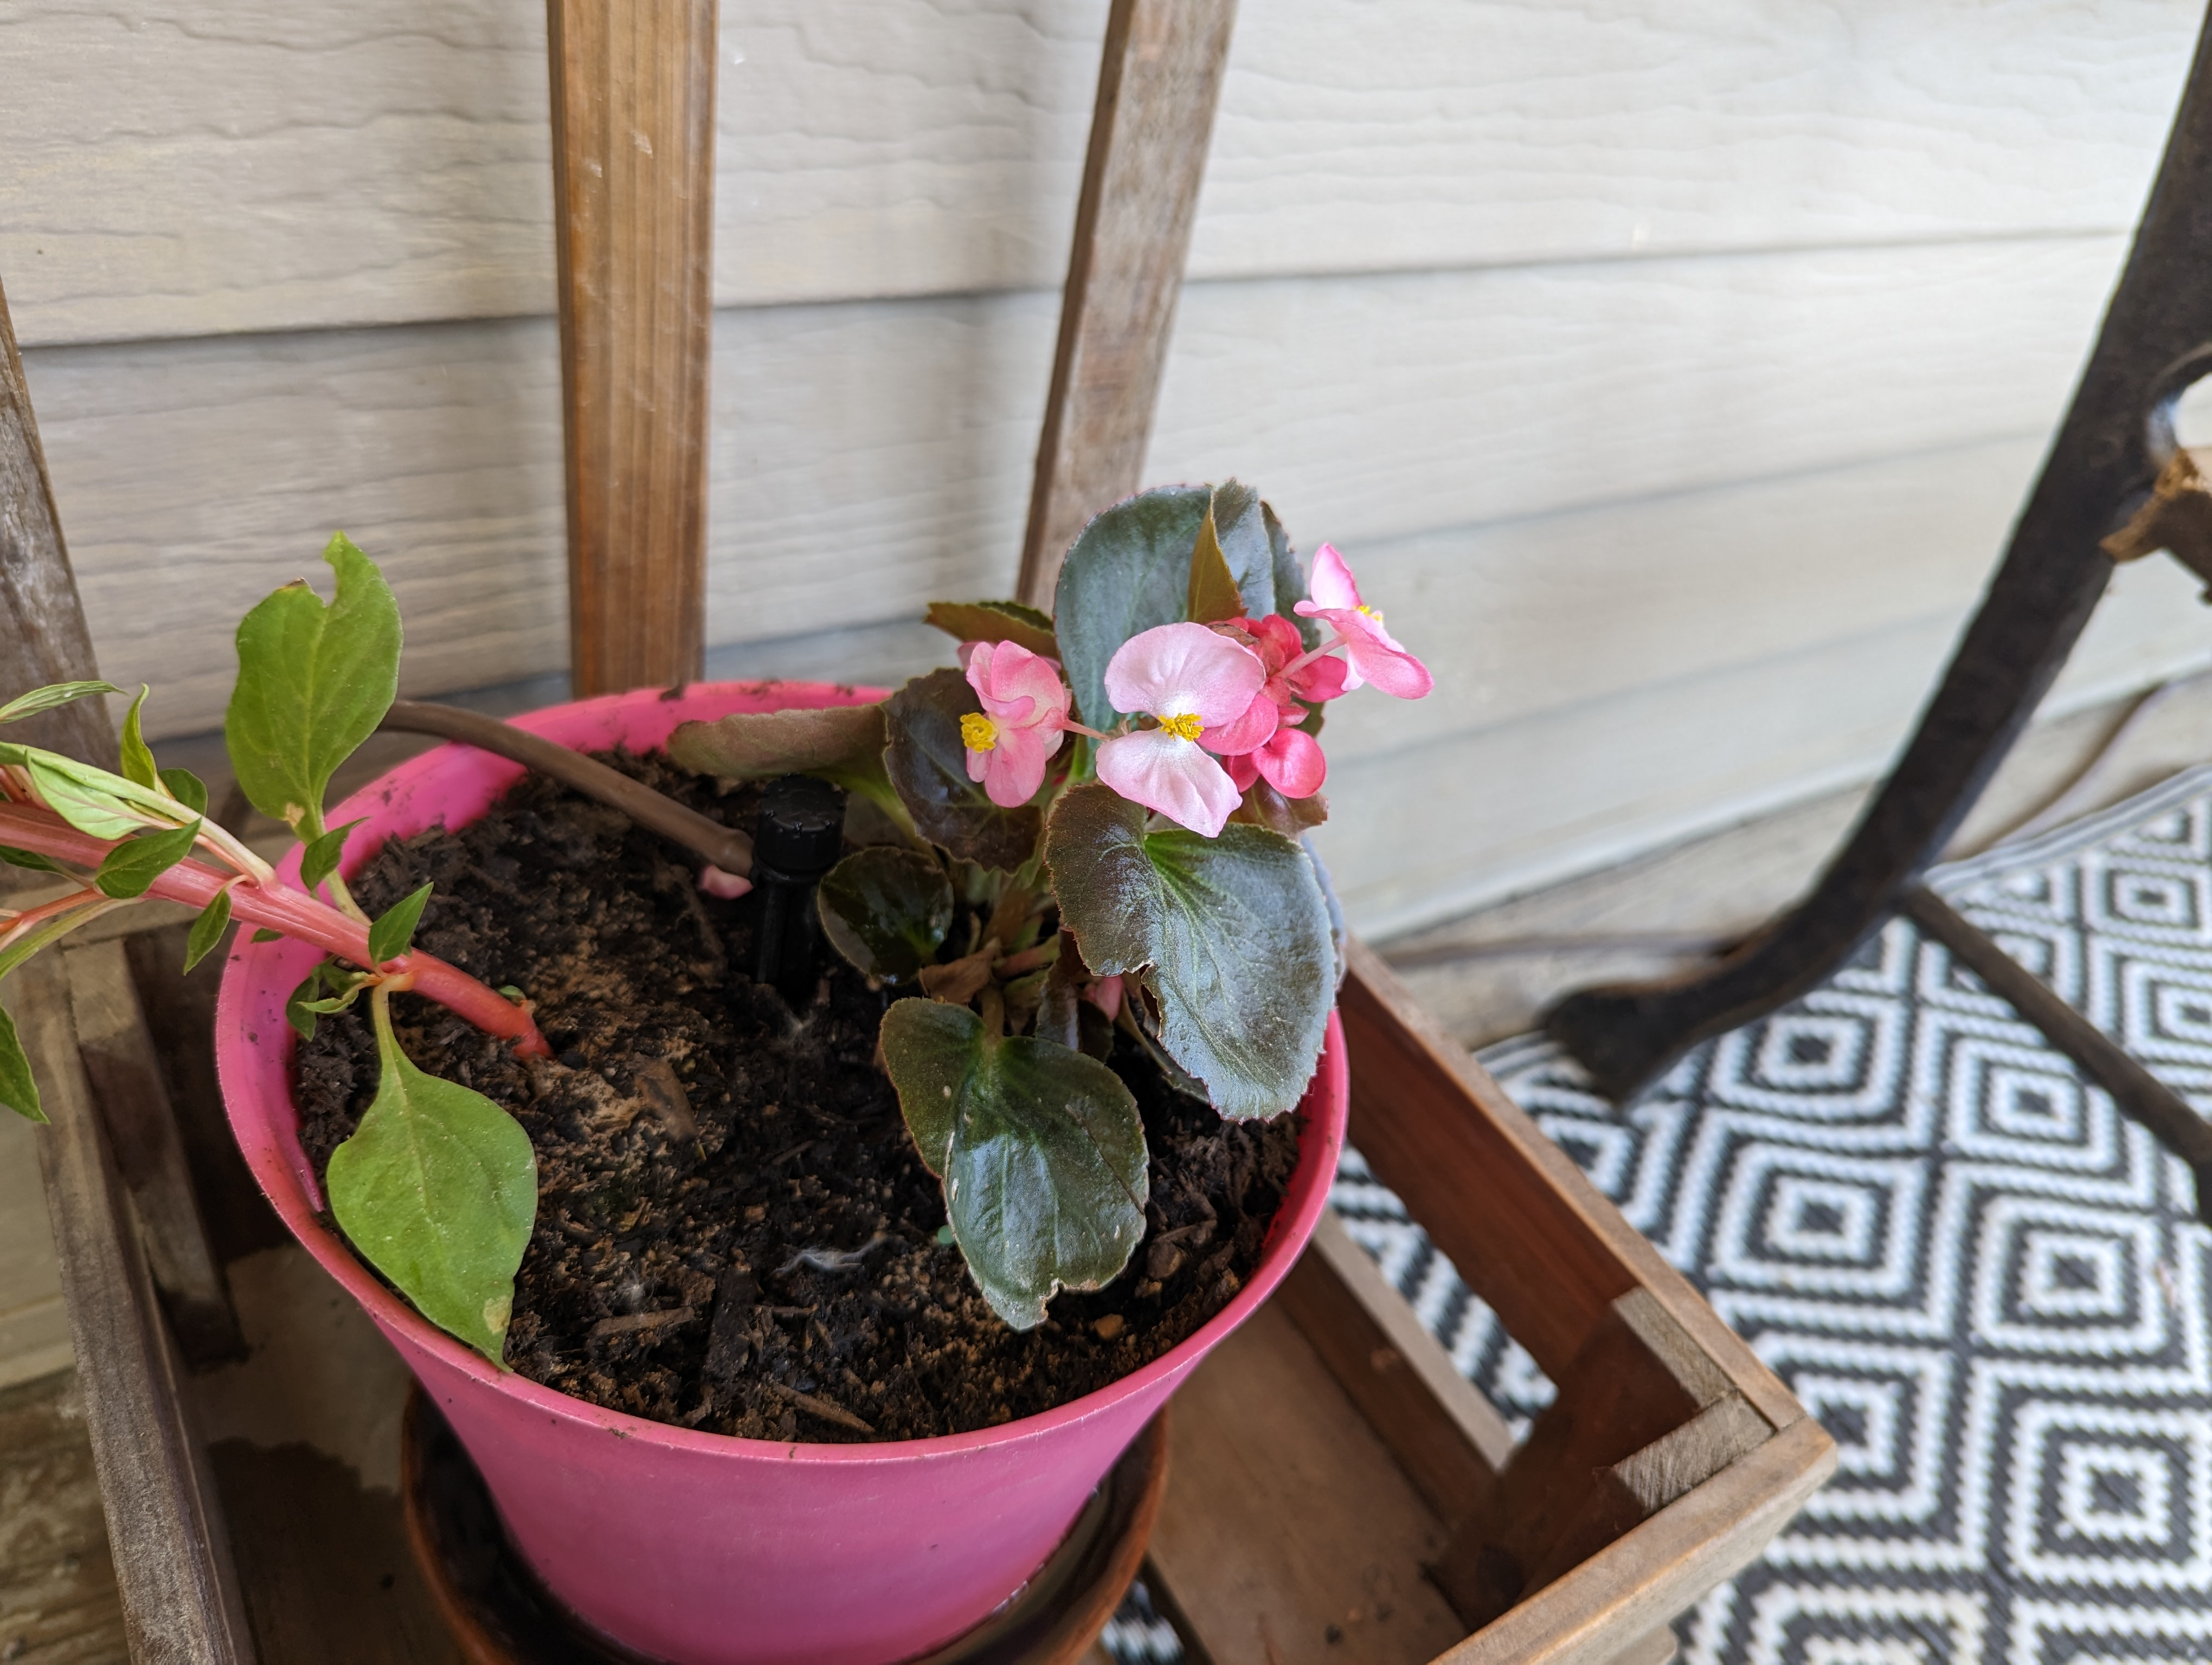
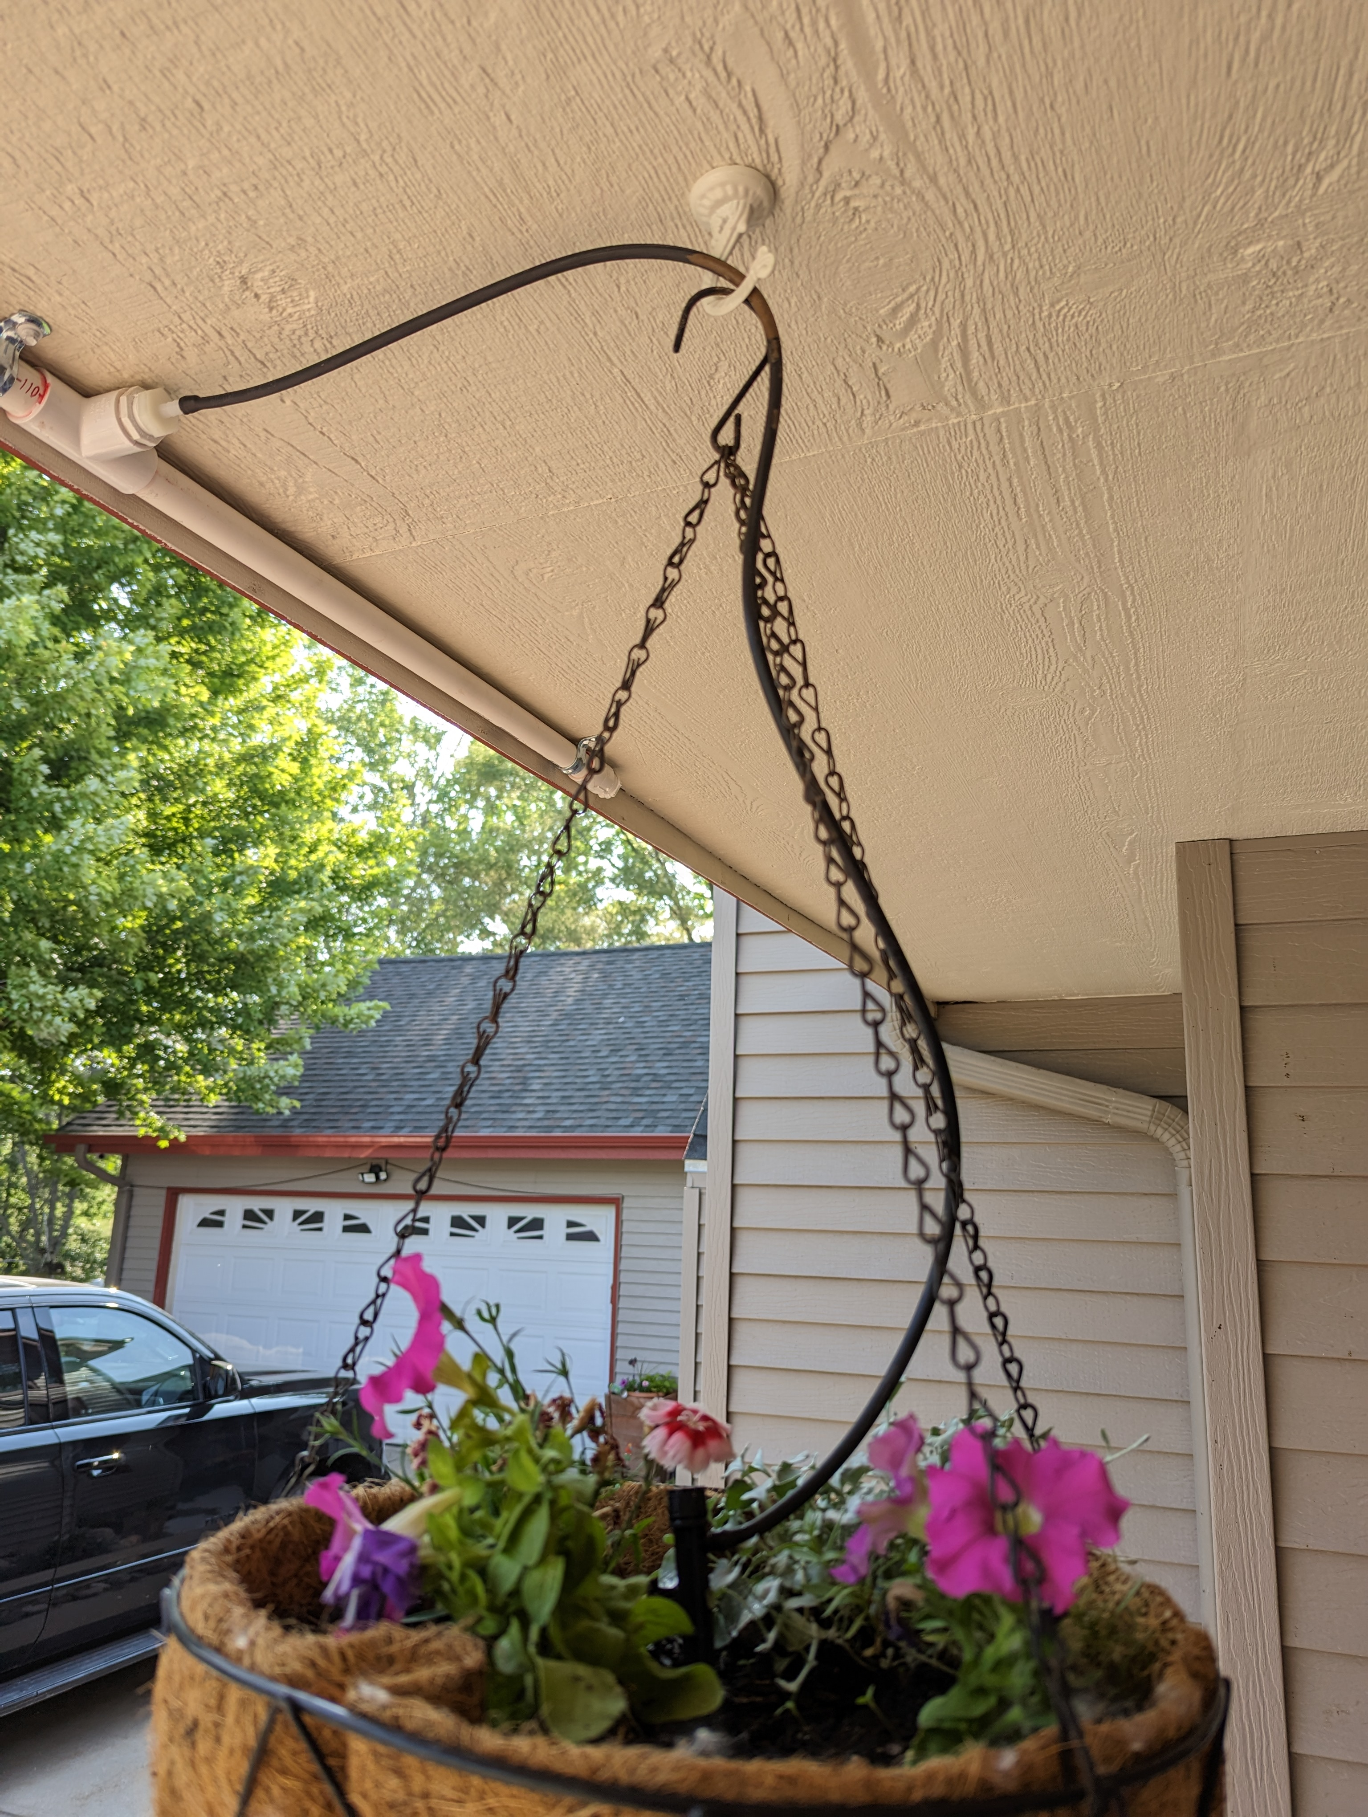

Slide 10
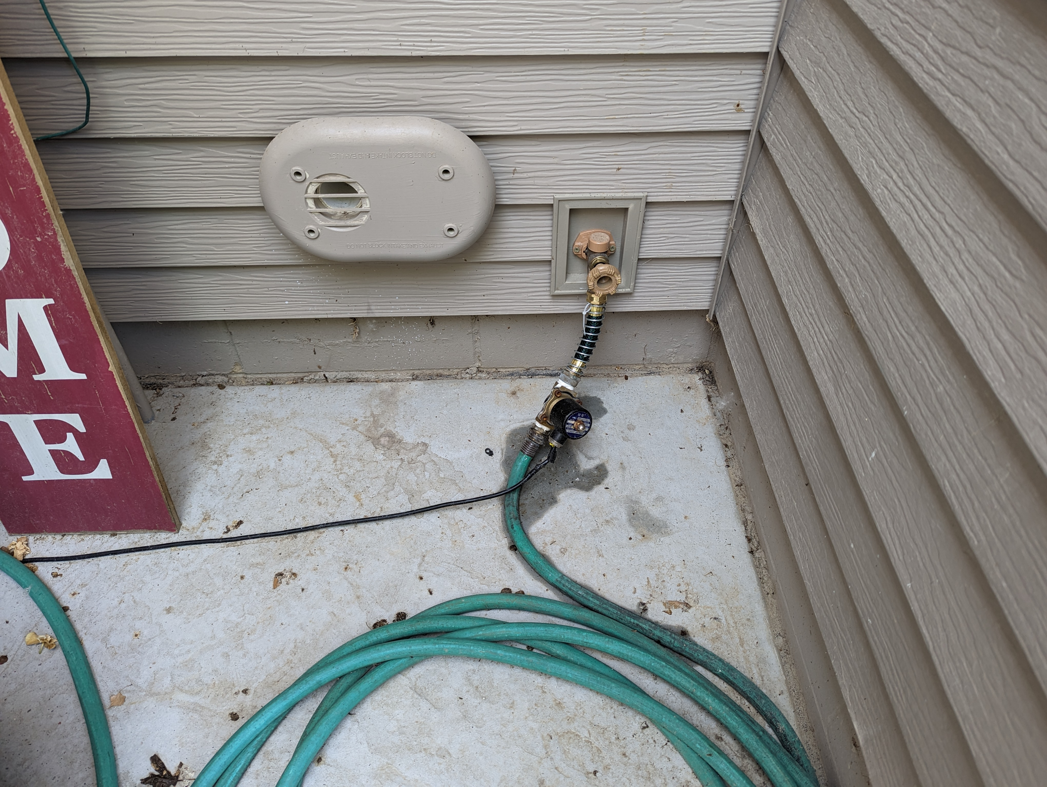
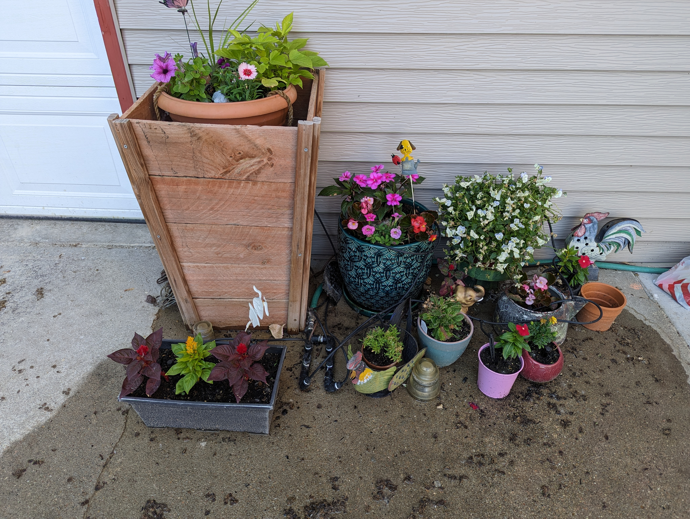
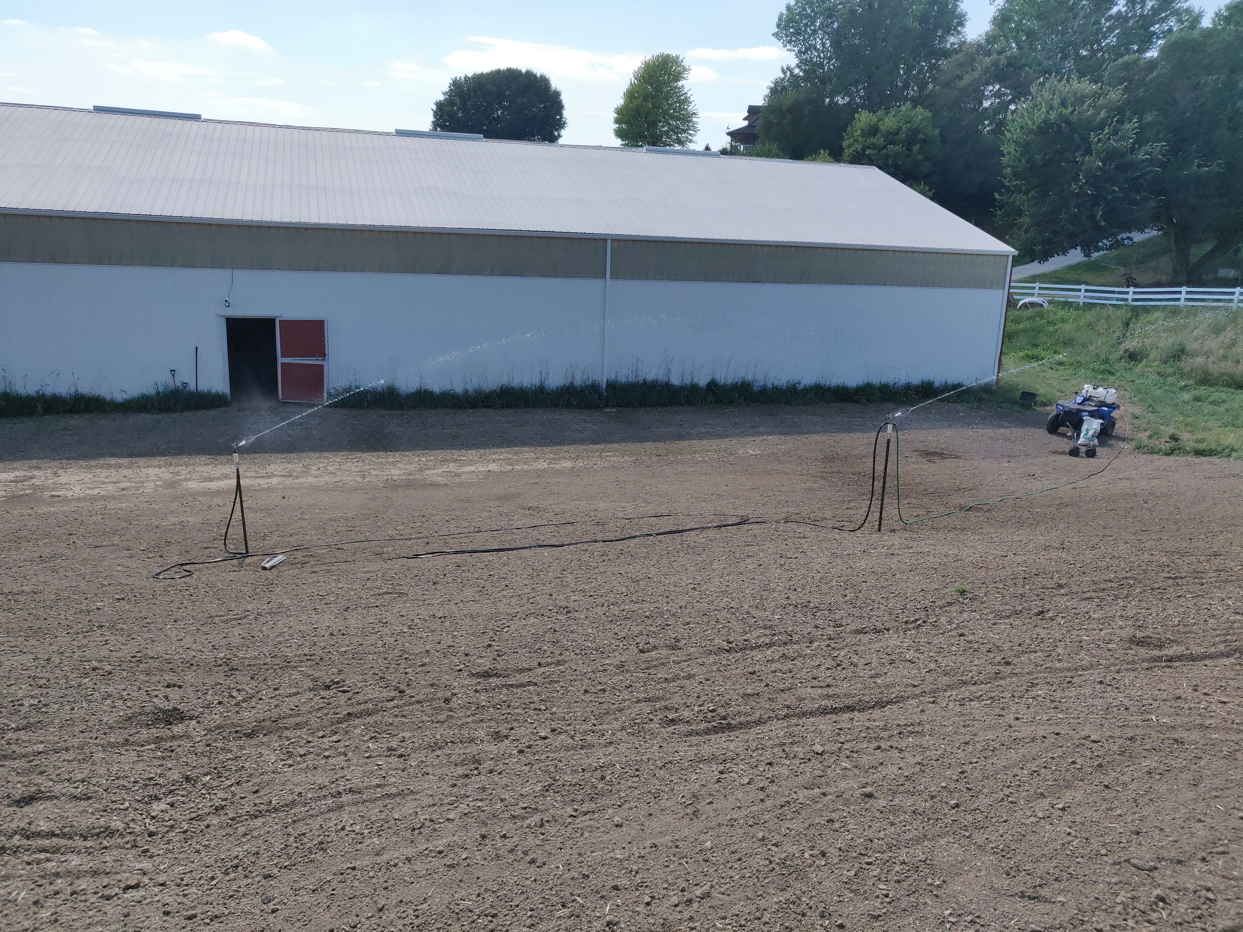
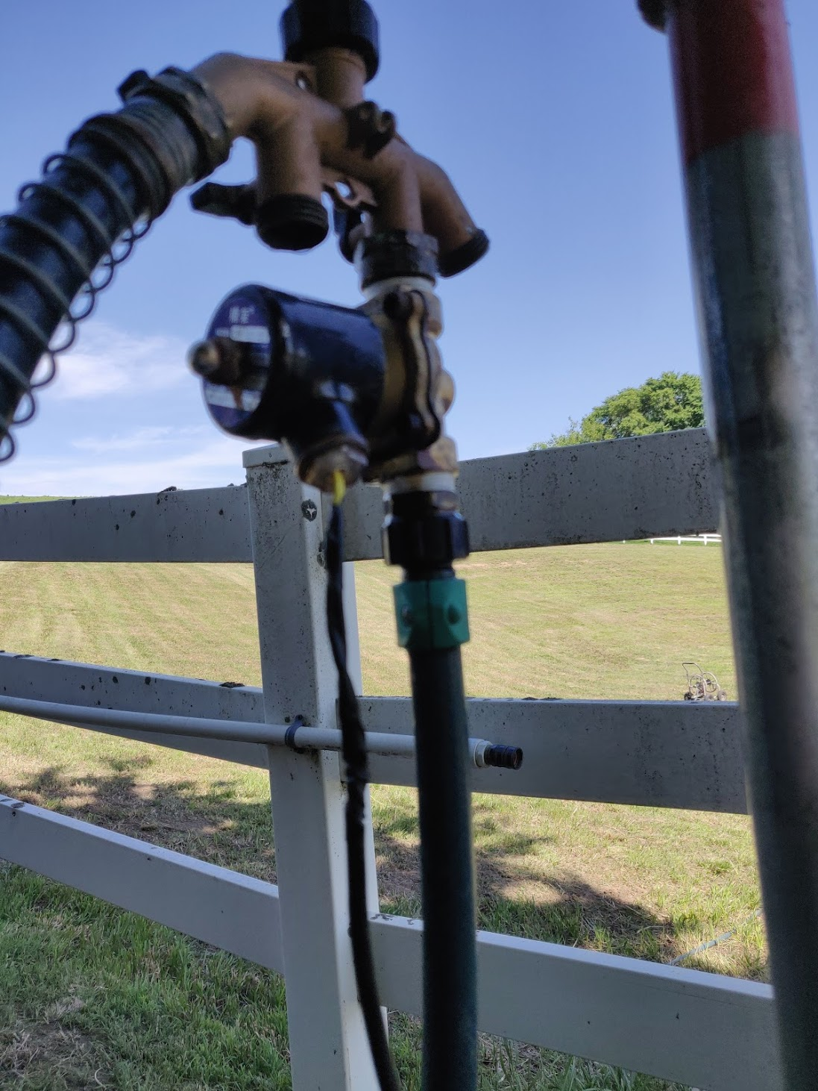
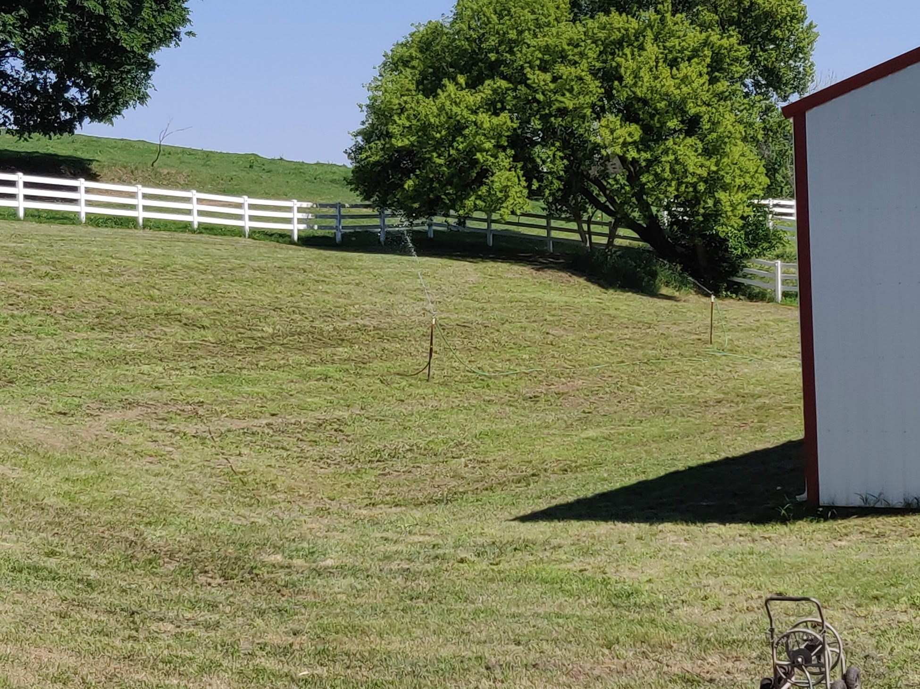
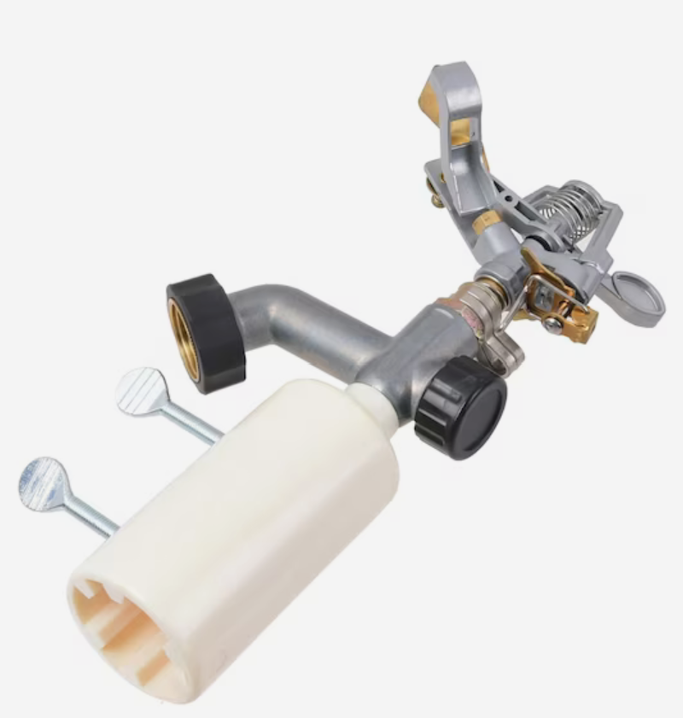

Slide 11
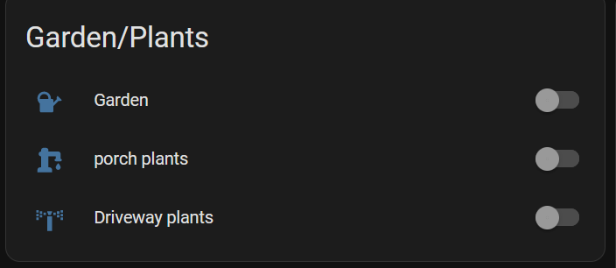
03
Hackery: No Cloud, No Way.
If a project doesn’t involve firmware, it’s probably not worth doing

Slide 12
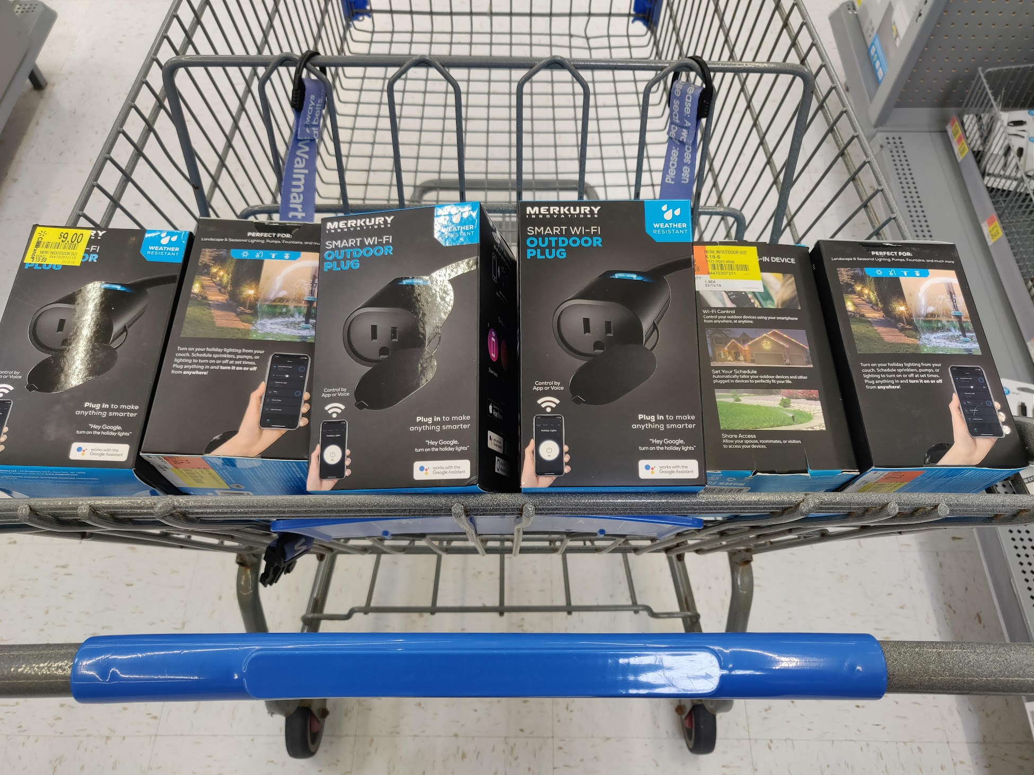
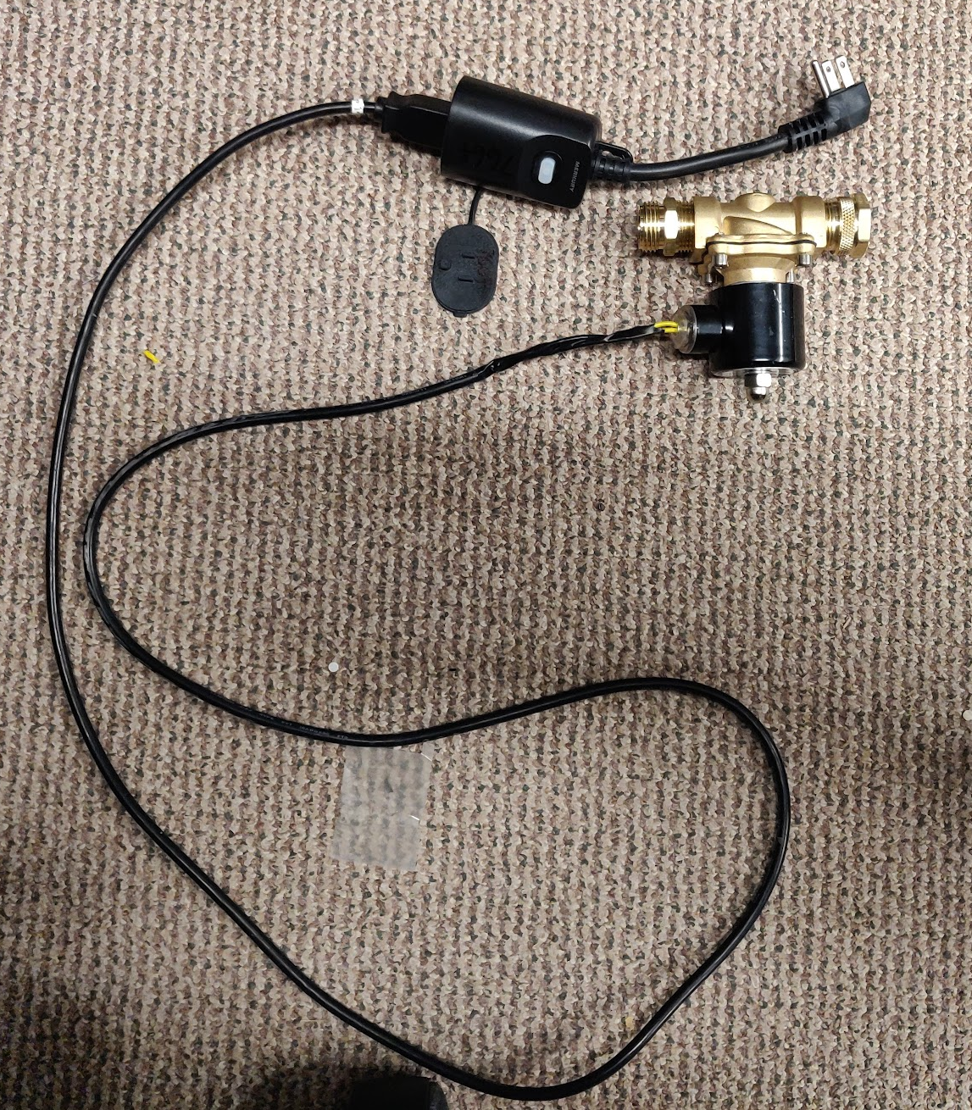
Verison 1: $5 Walmart Special
Merkury brand outdoor smartplug
$5 on clearance (thanks slickdeals forums)
Many Walmarts, such deal hunting
ESP8266 based controller -> Tasmota (tasmota.github.io)
Originally via Tuya-Convert
Chips are now Beken (non ESP)
Can still flash via soldering or using Tuya-Cloudcutter
Controlled via Home Assistant (www.home-assistant.io)
Match up with cheap 110v solenoid valve from Amazon
Locally-controlled valve for switching water on/off using any standard 110v power source
Huge assumption: Wifi available everywhere water control is desired
Simple to wire – no special tools, just basic pipe thread to garden hose thread adapters and a basic power cord pigtail
Used many garden hose “T” adapters to have multiple valves connected to a single spigot. Worked, but…leaky and ugly.

Slide 13
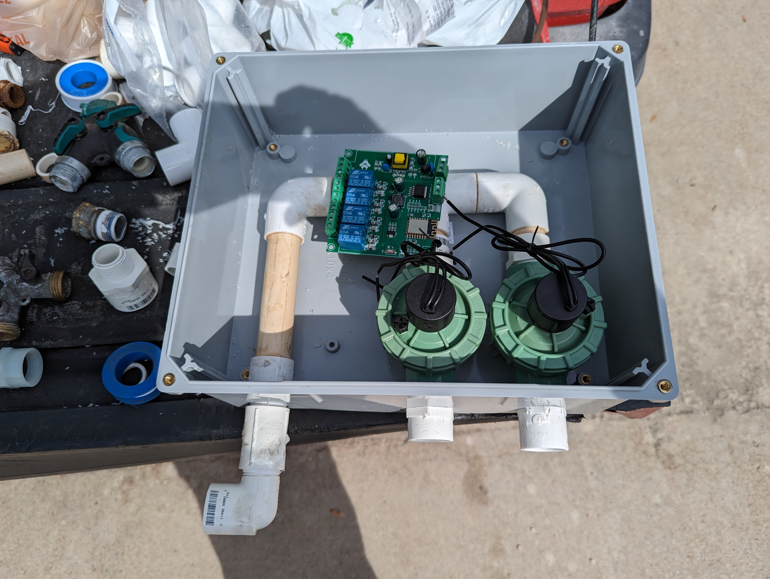
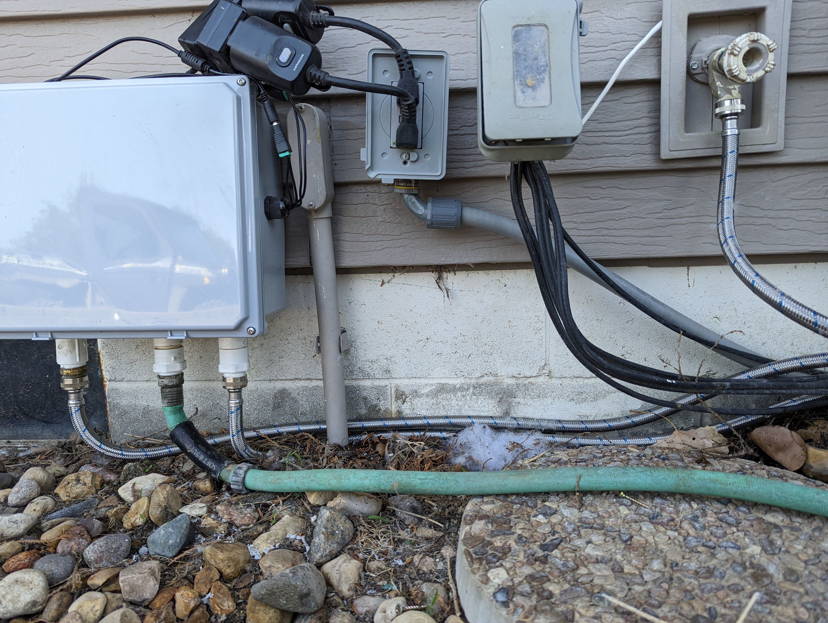
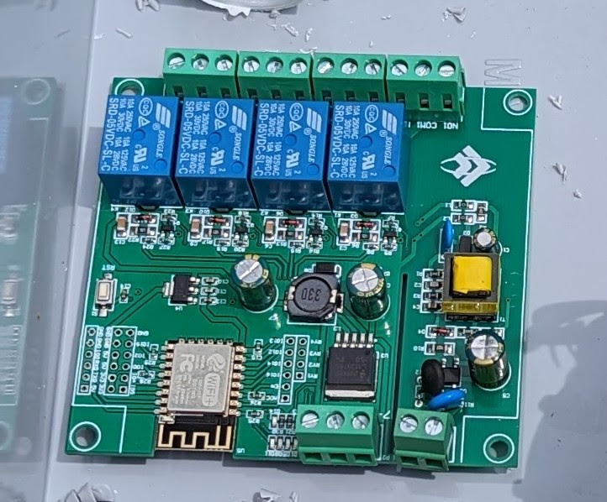
Verison 2: Relay Board + PVC Idiocy
Re-used outdoor enclosure
$8 Amazon warehouse Orbit sprinkler valves (24volt)
Threaded PVC pieces to allow for disassembly
4-relay ESP8266-based board for relay control
ESP flashed to Tasmota firmware (tasmota.github.io)
Currently using 2 relays, expandable to 4 relays/4 valves
All 4 relays controllable via Home Assistant (www.home-assistant.io)
Relay board cost $5 or so on Aliexpress
3amp/24v power brick powers relay board
Relay board controls power to valves as configured
Plastic enclosure does not interfere with wifi signal
Washing machine hose to connect input to water spigot
Washing machine hose also connects to hanging plant PVC pipe distribution
Direct hose connection for garden irrigation

Slide 14
04
What’s next…
As long as some other shiny project doesn’t distract me….

Slide 15
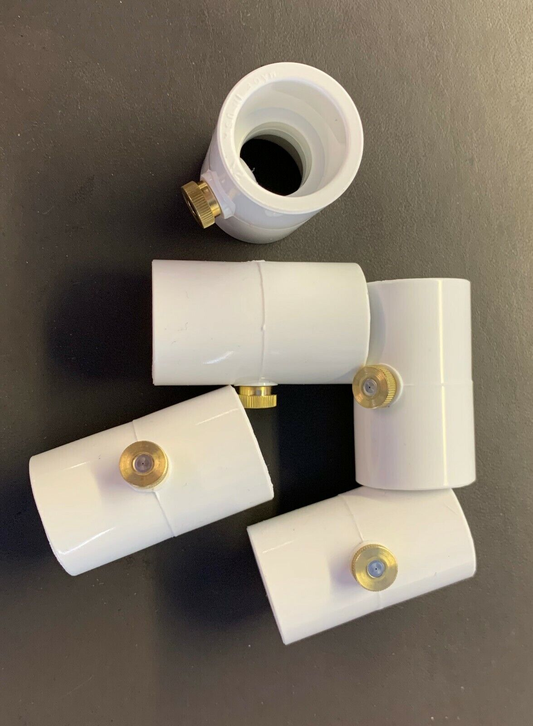
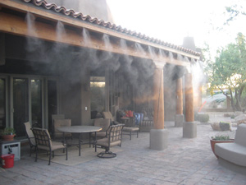
Changes and iterations
Add misting system for cooling on porch/deck
Requires a 2nd PVC run (yuck, more work) or low voltage valve for each hanging plant
Also requires low voltage valve for every spray mister (nbd)
These are cheap on ebay, $2 each
Use ESP32 outdoors for BLE proxy
Potentially swap relay board ESP8266 for ESP32-C3 (which has Bluetooth capabilities)
Add ESP32 dedicated for BLE inside outdoor enclosure tapping 3.3v output from the existing power on the relay board and run OpenMQTTGateway firmware
BLE proxying enables:
BLE plant soil moisture sensors
Individual soil monitoring for every plant
Since every plant has a shutoff valve, I can specifically water each plant, individually, as needed
Excellent for expansion to blueberry/cherry bushes and other fruit crops that can grow in flower landscape area

Slide 16
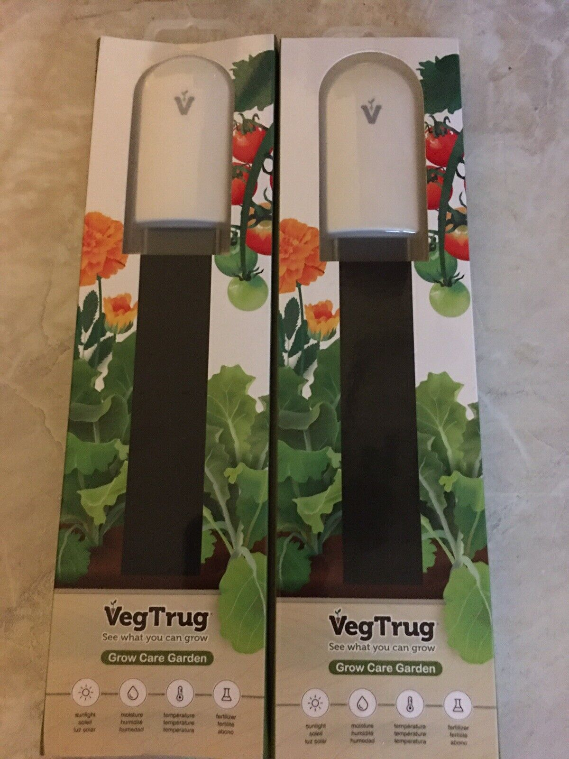
Changes and iterations
Run water to garden via buried pipe rather than hose
Add multiple zones for garden area using low voltage valves and additional ESP32 boards to enable multi-zone control.
Use BLE soil monitors to individually irrigate different crops or zones as needed
Clean up cabling, paint all the PVC pipe to match porch roof/siding/etc
Better node-red flow/automation control for rain and watering amounts
Very basic controls now using data from on-site weather station:
“if previous 24 hour rain total is > .25”, do not run today”
Global disable based on bool value
Stand-alone/offgrid solution for watering
Solar light with 18650 batteries (disconnect light)
ESP32 devboard, relay, 3.3v pump, basin with water level sensor, soil moisture sensor
Fully automated watering and self reporting of “empty” water basin via Home Assistant/mqtt

Slide 17
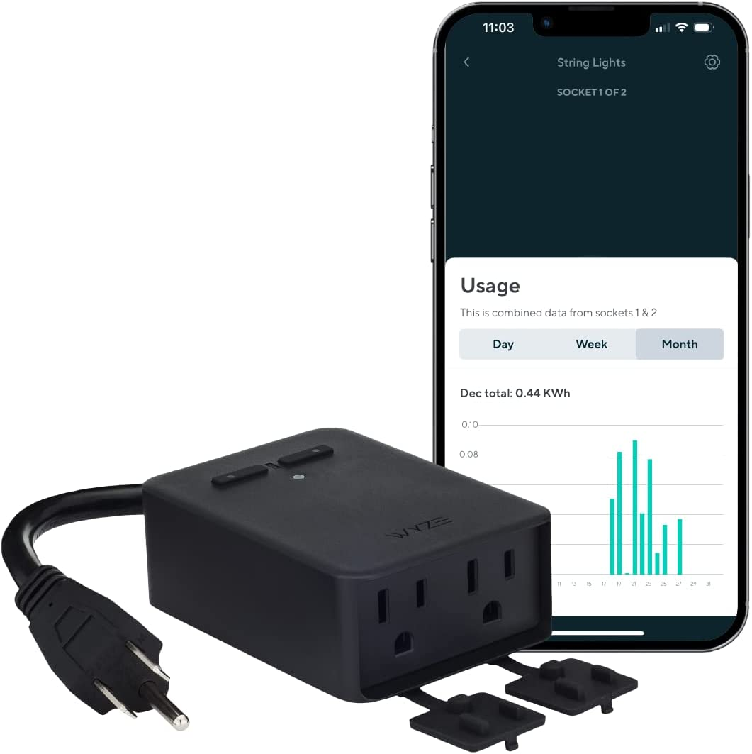
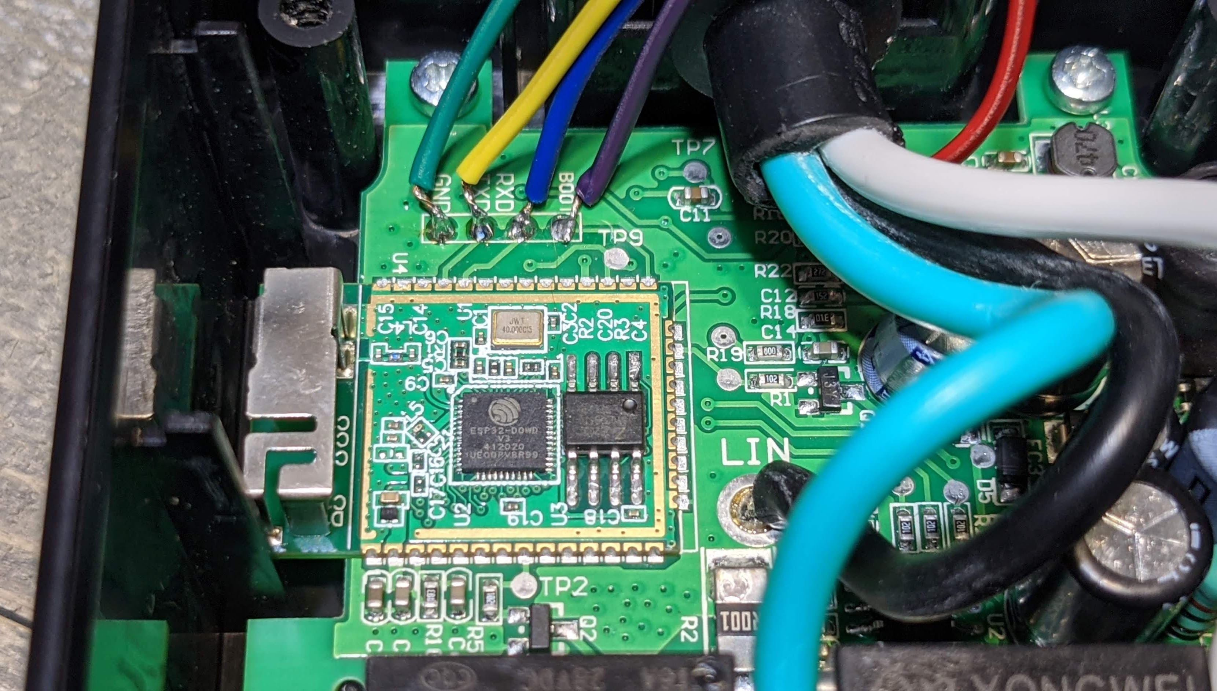
Changes and iterations
For individual valve control, single or dual zone – use a Wyze outdoor smartplug
ESP32-based – excellent BLE
Dual-sockets with individual control
Requires soldering to flash to Tasmota or ESPHome, but very accessible datapoints
CHEAP!
Excellent documentation for disassembly and flashing

Slide 18
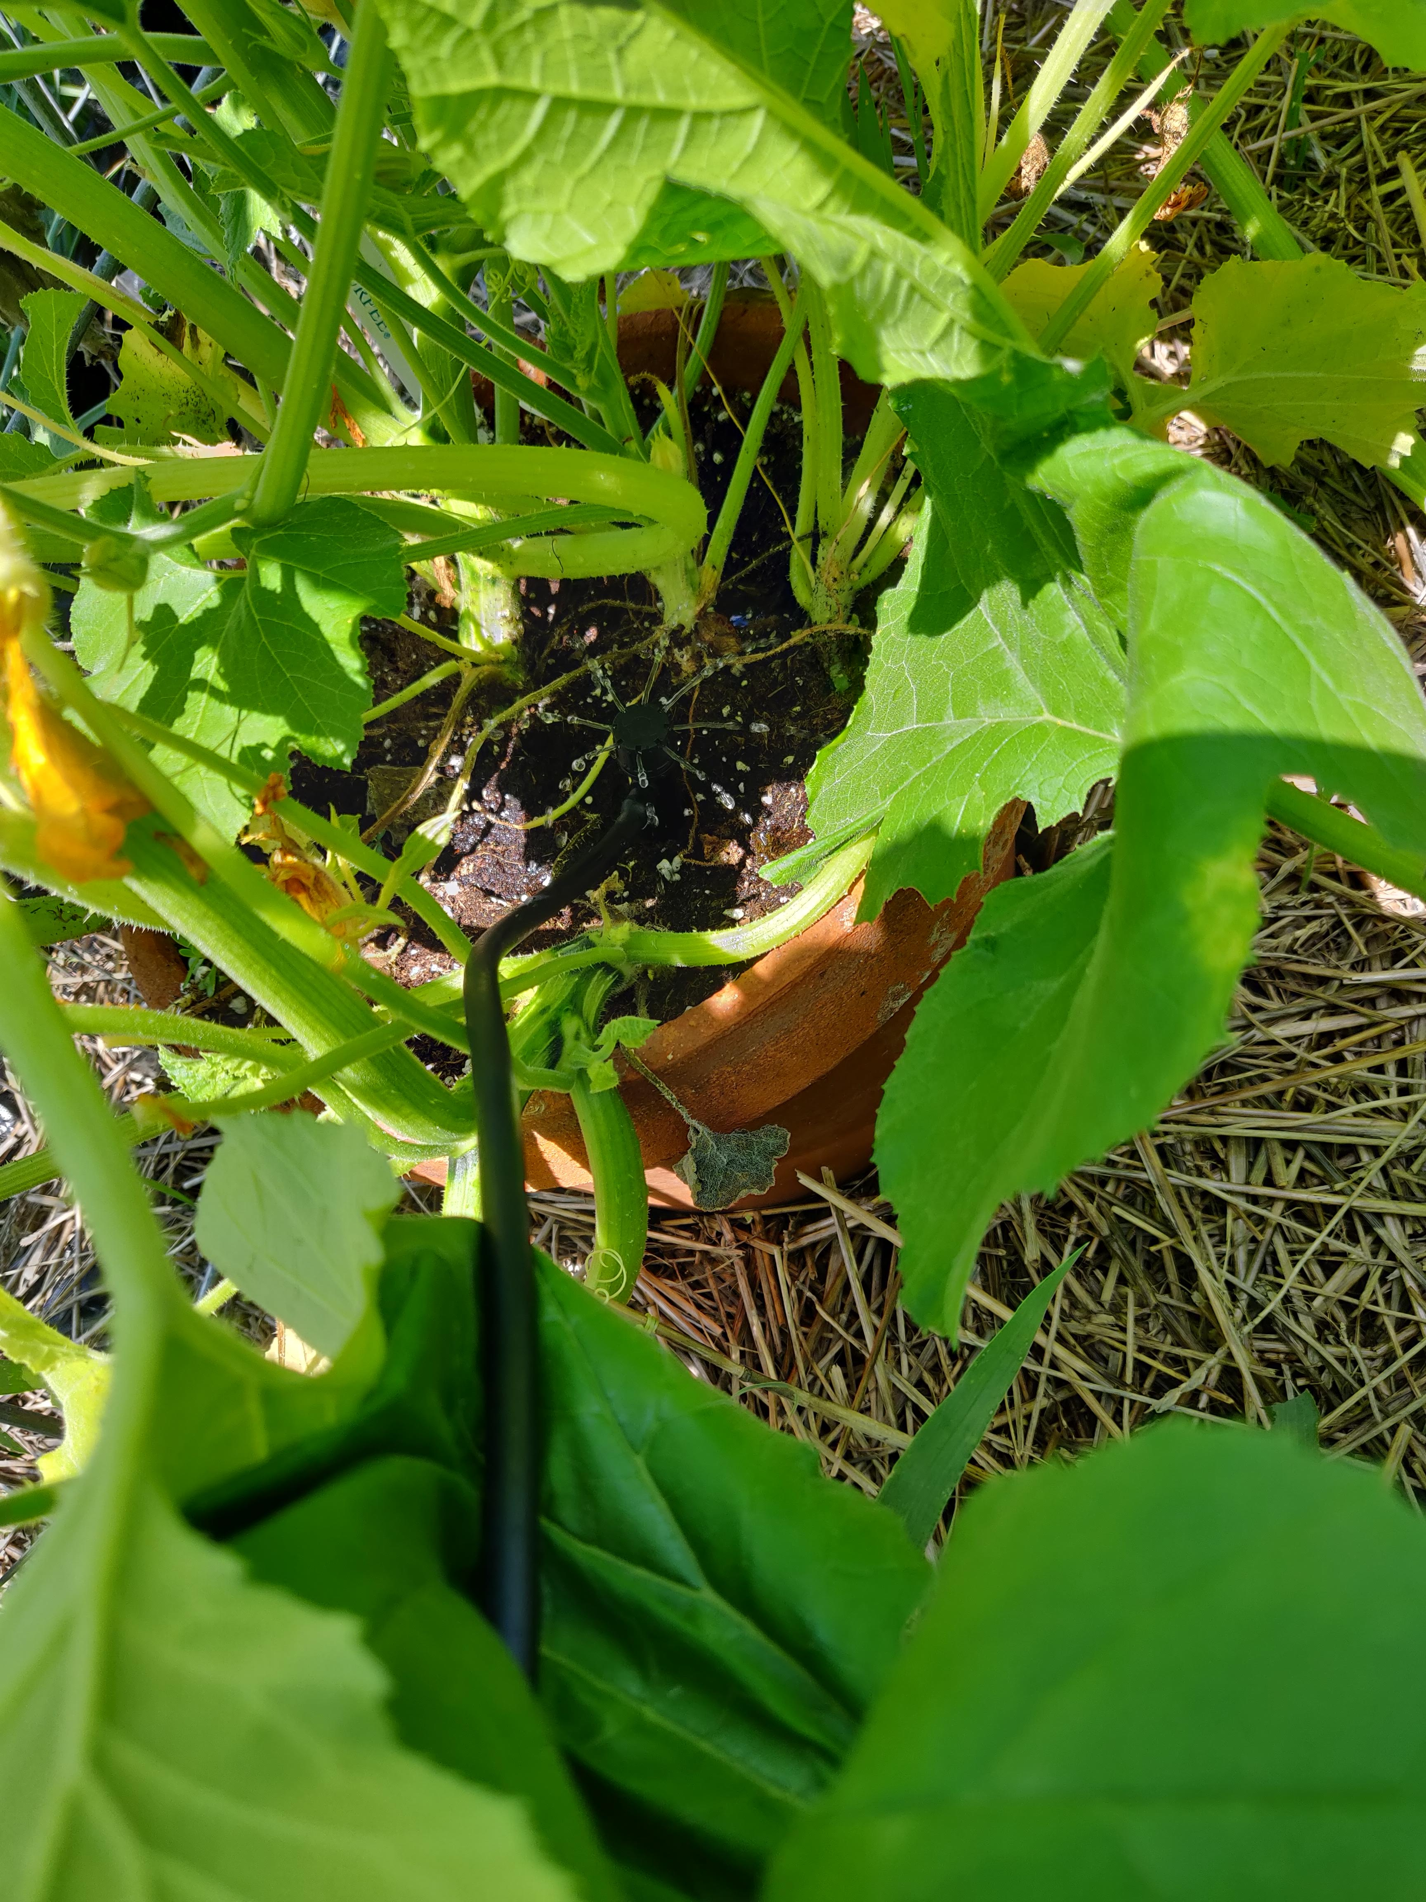
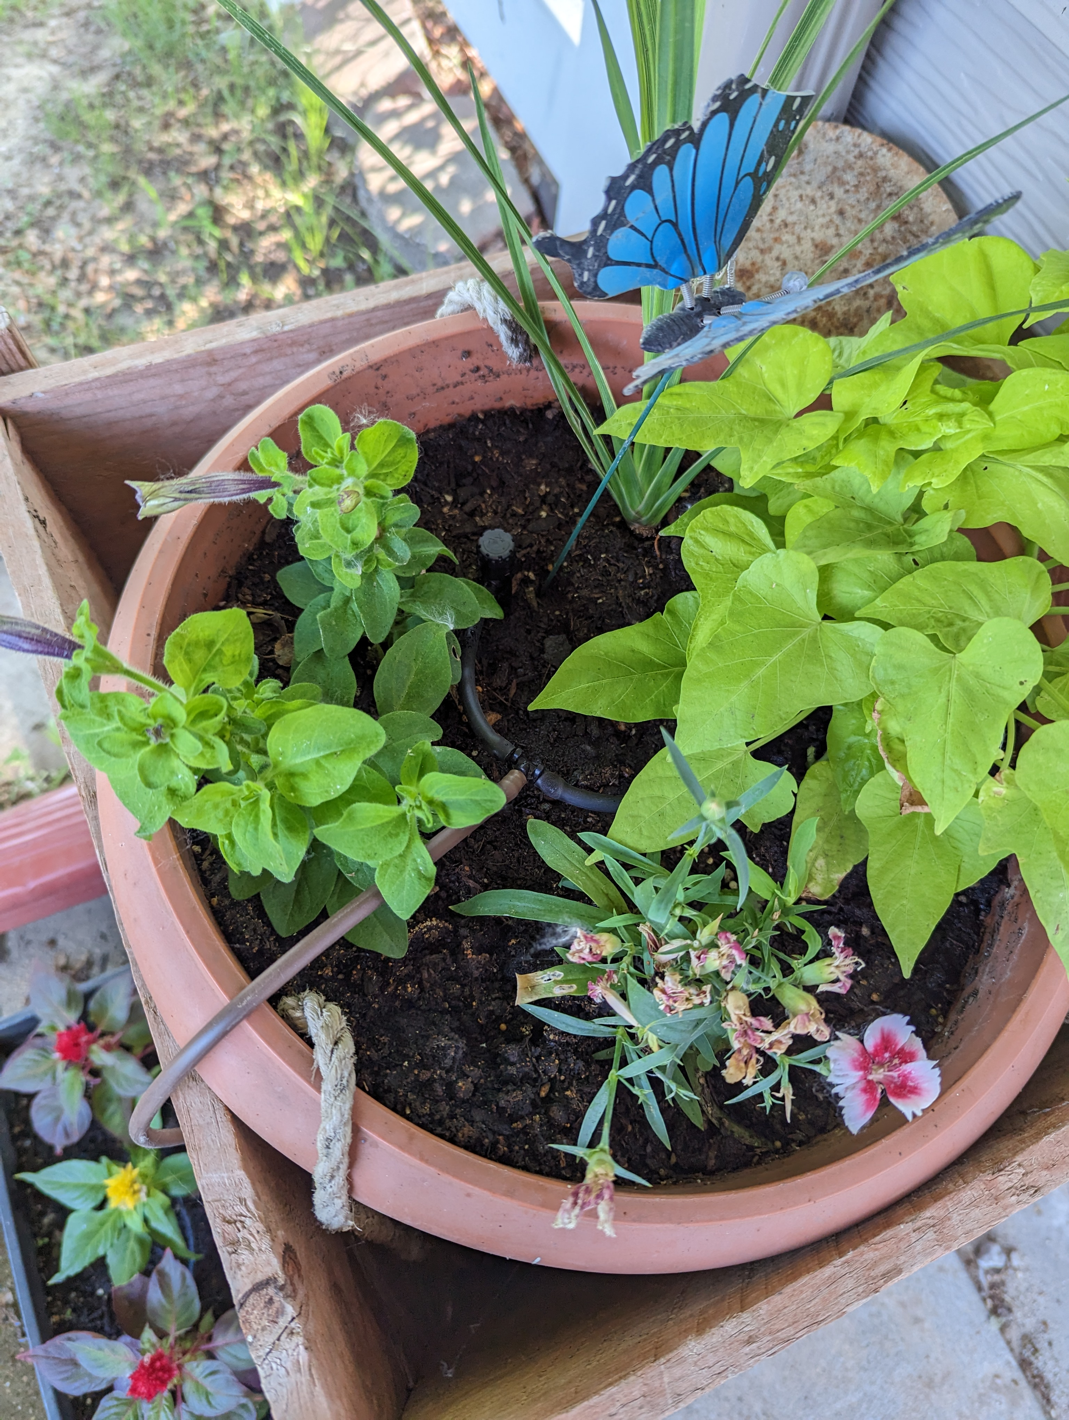
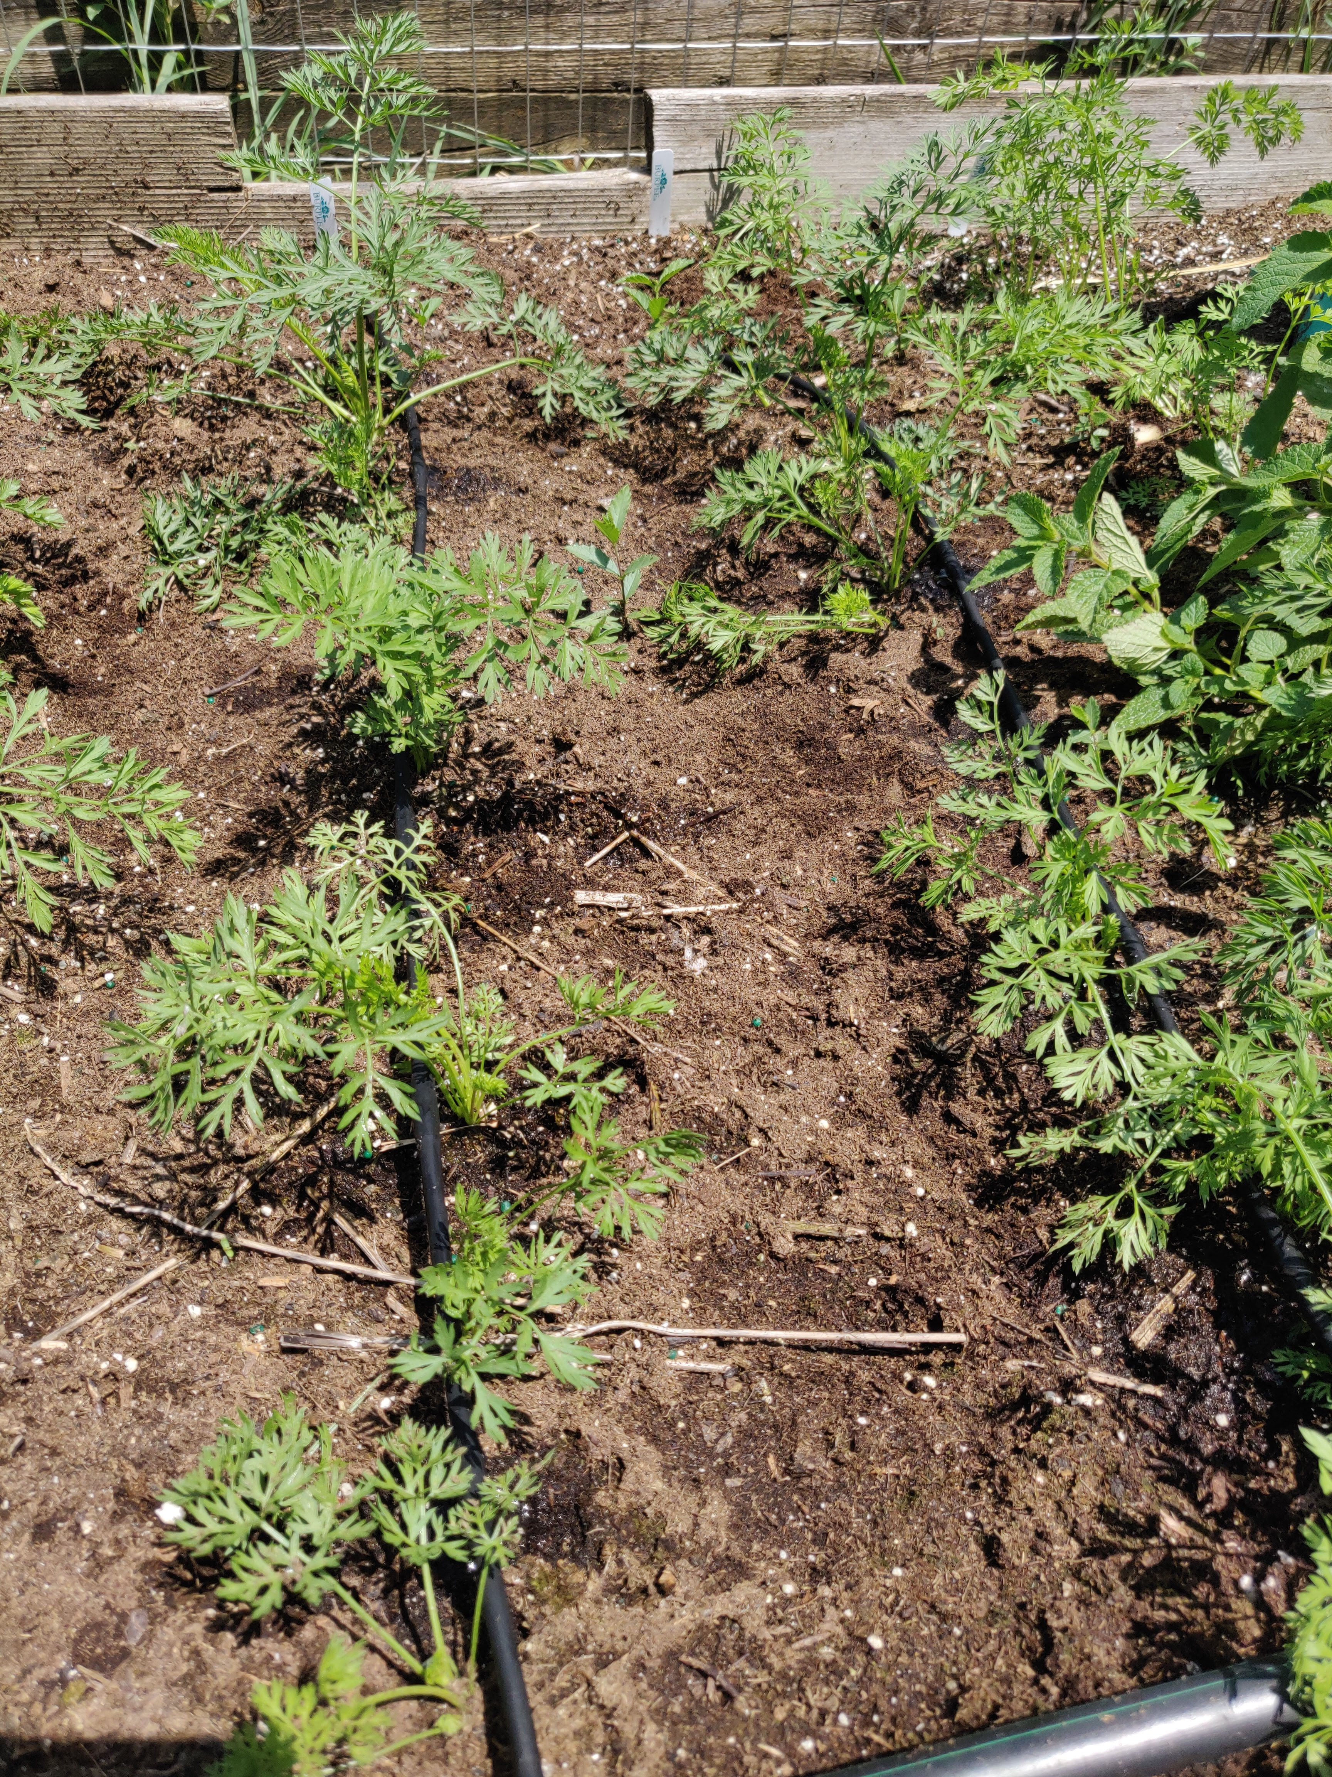
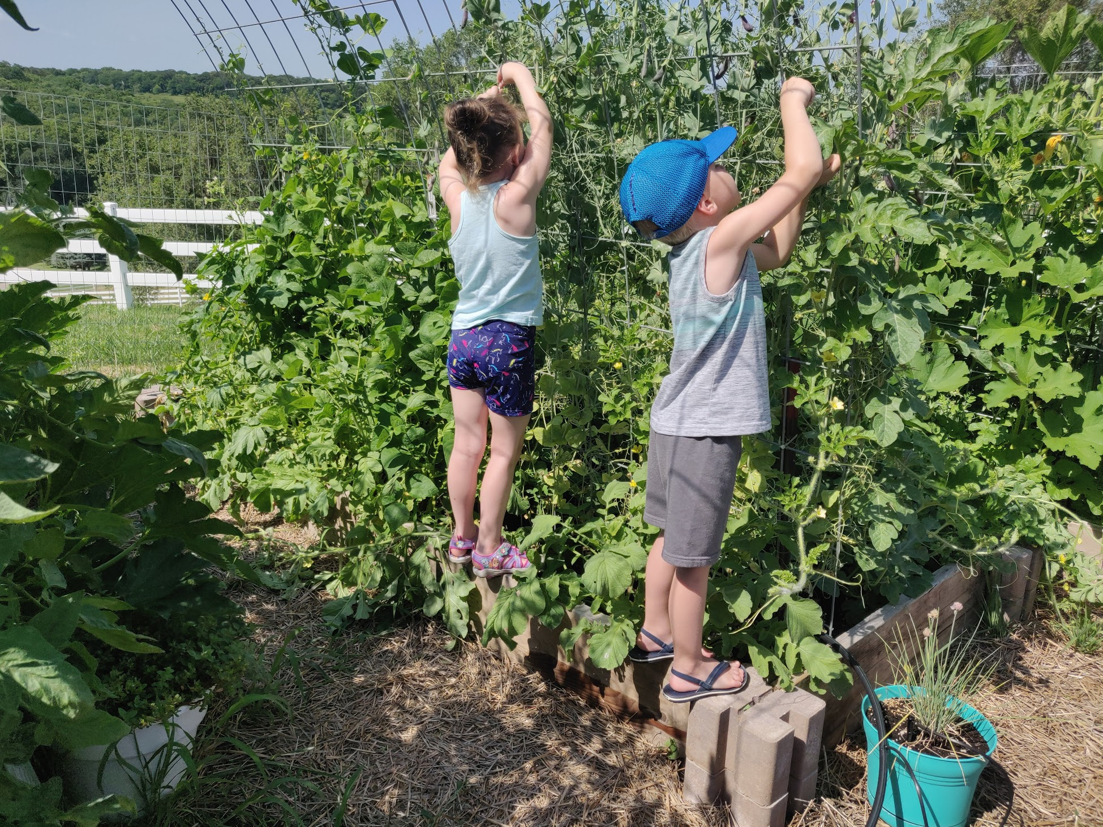

Slide 19
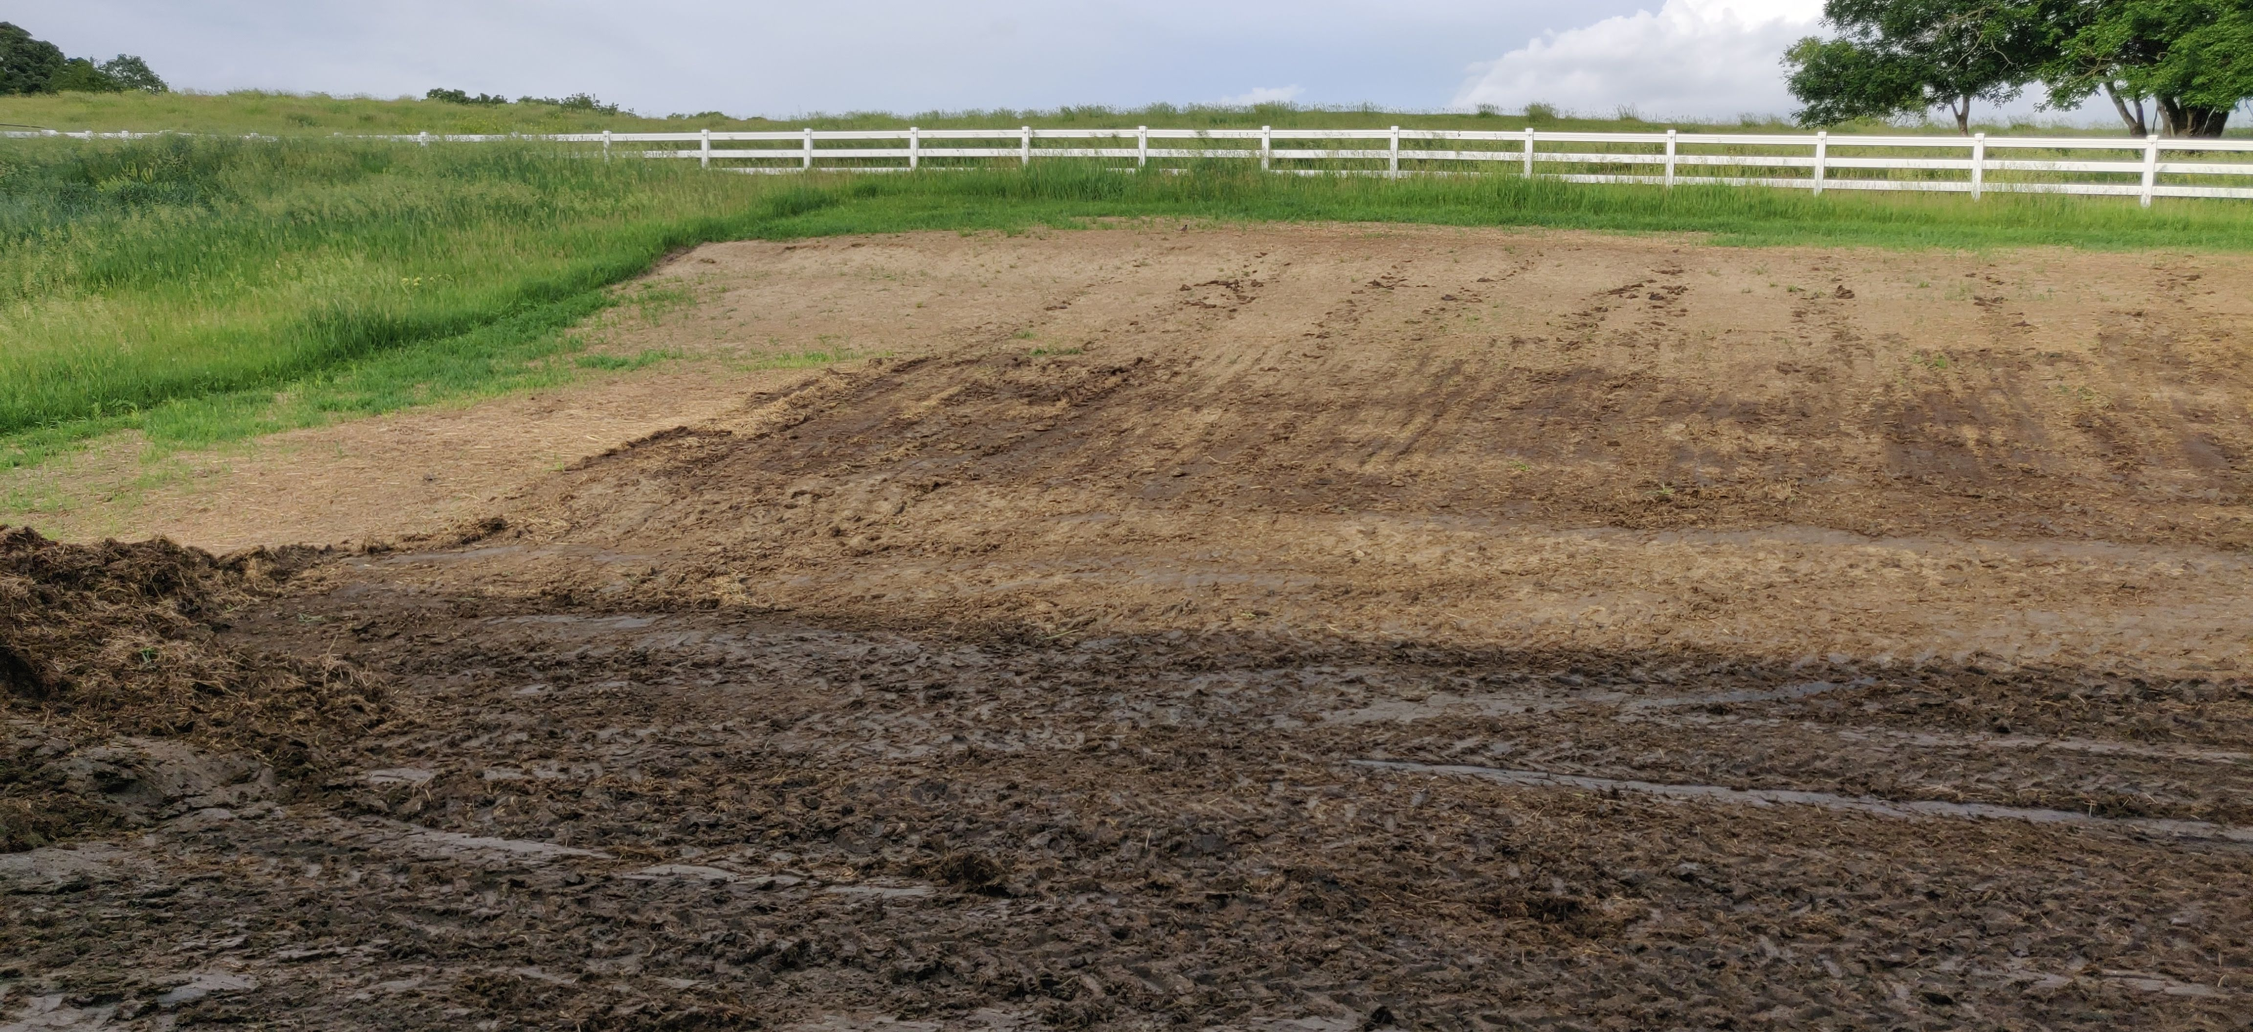
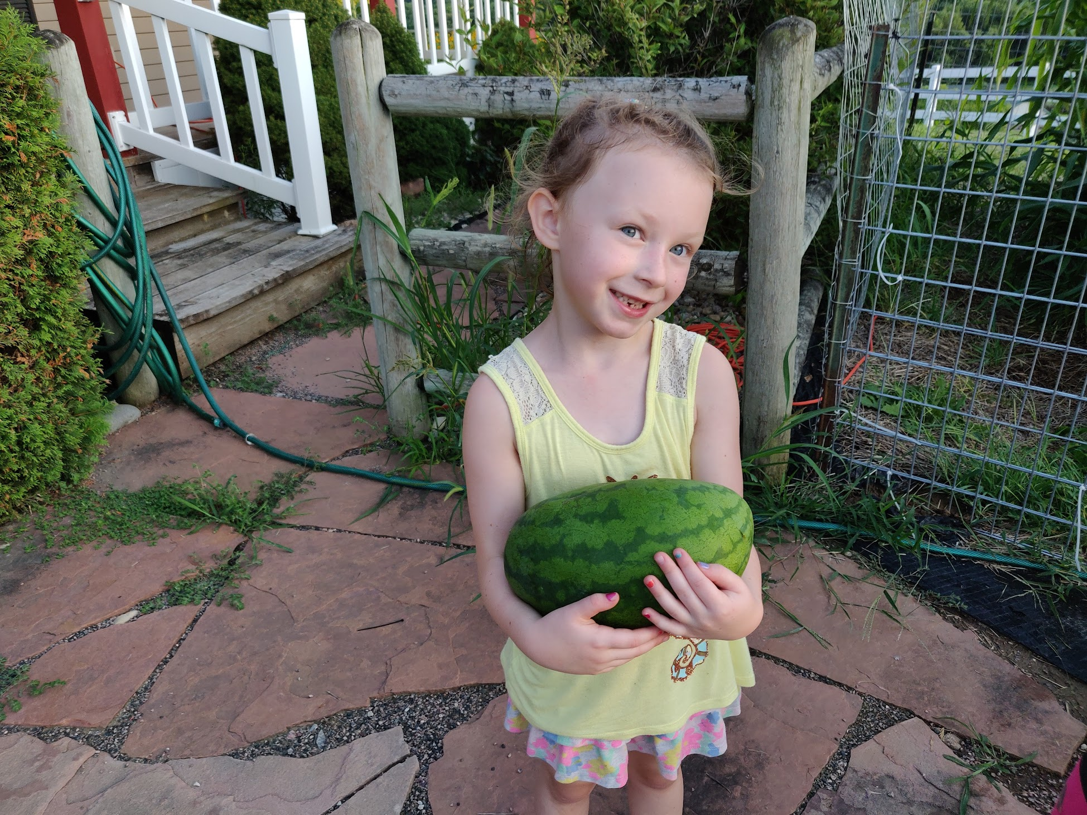
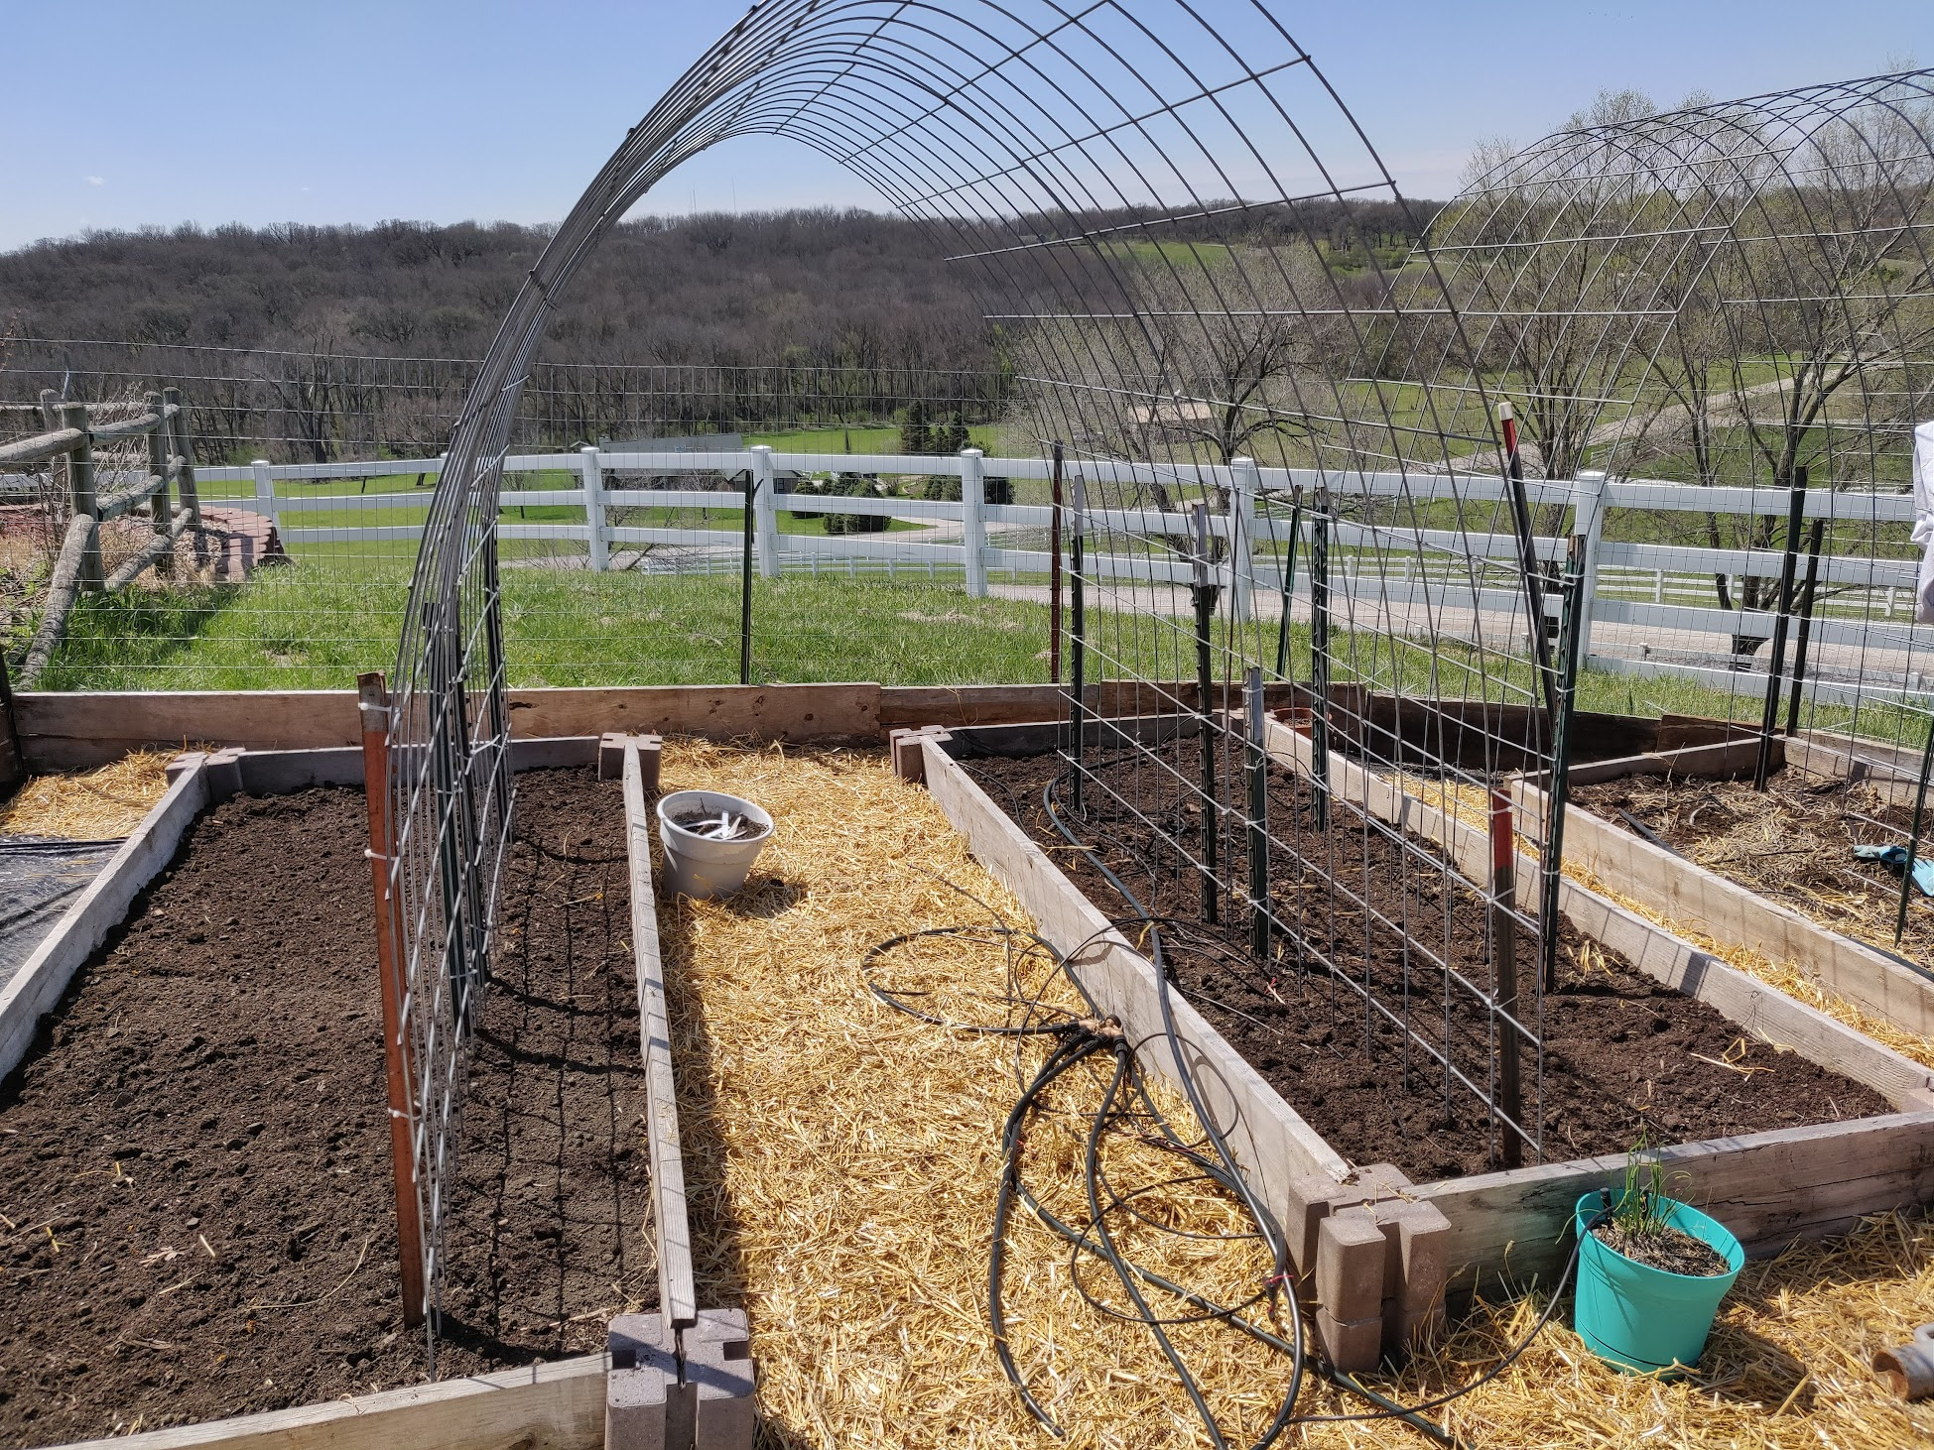
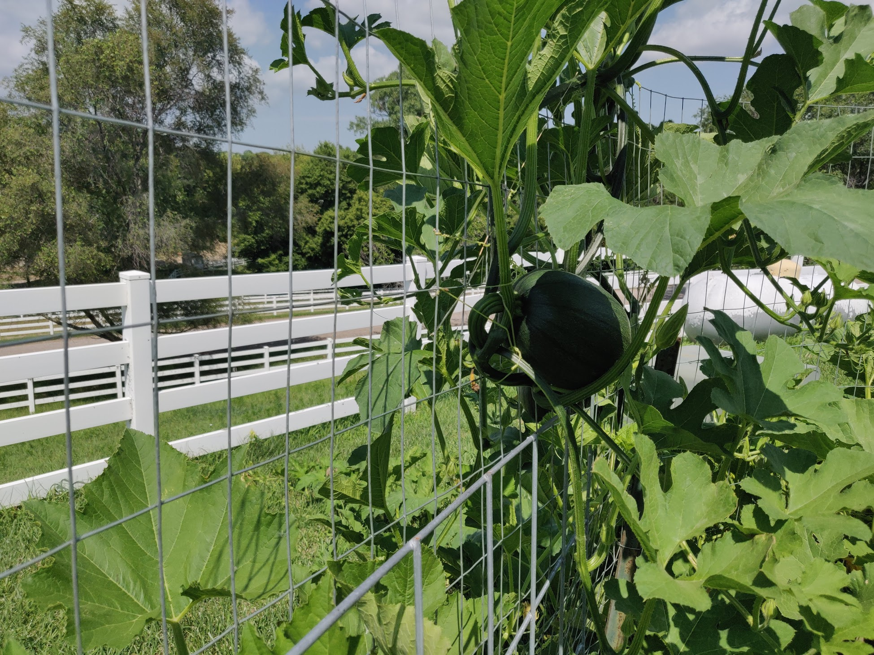

Slide 20
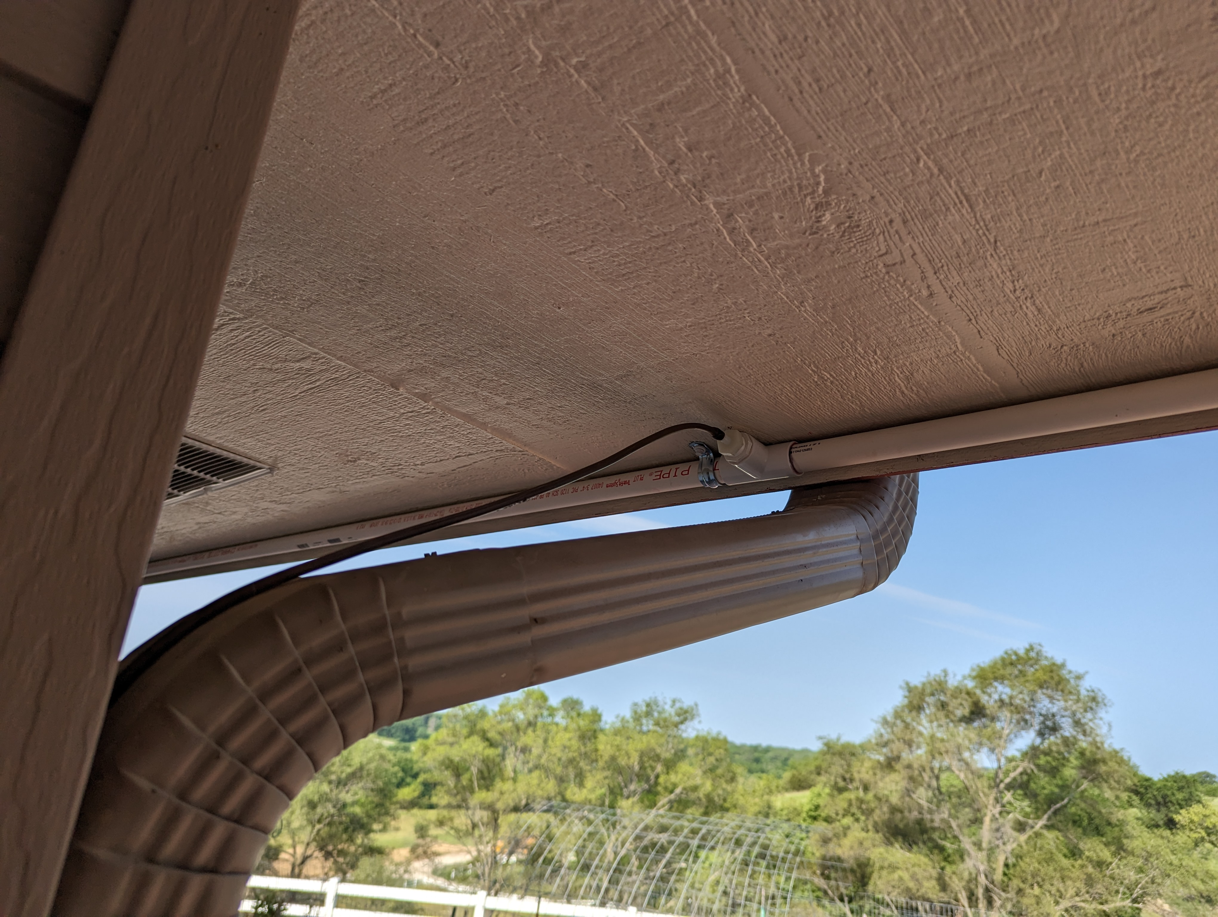
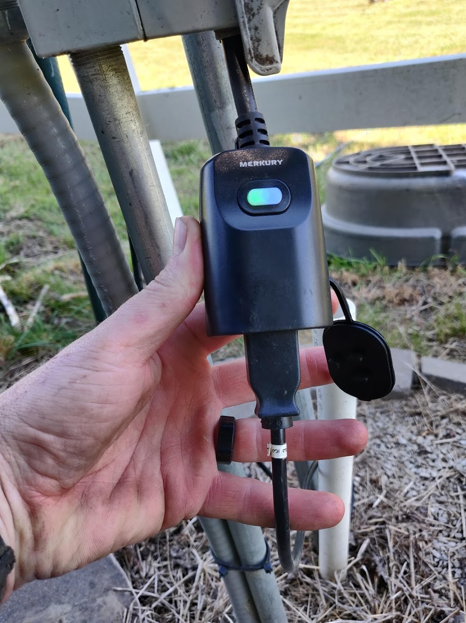
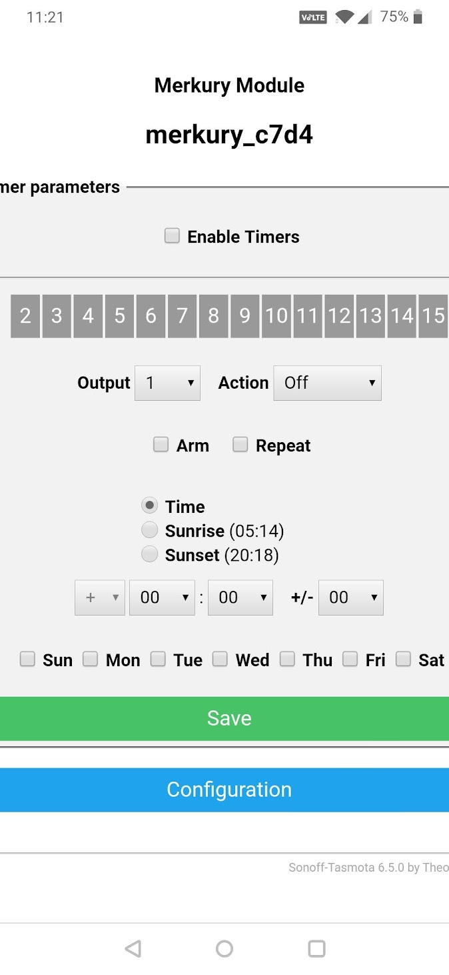
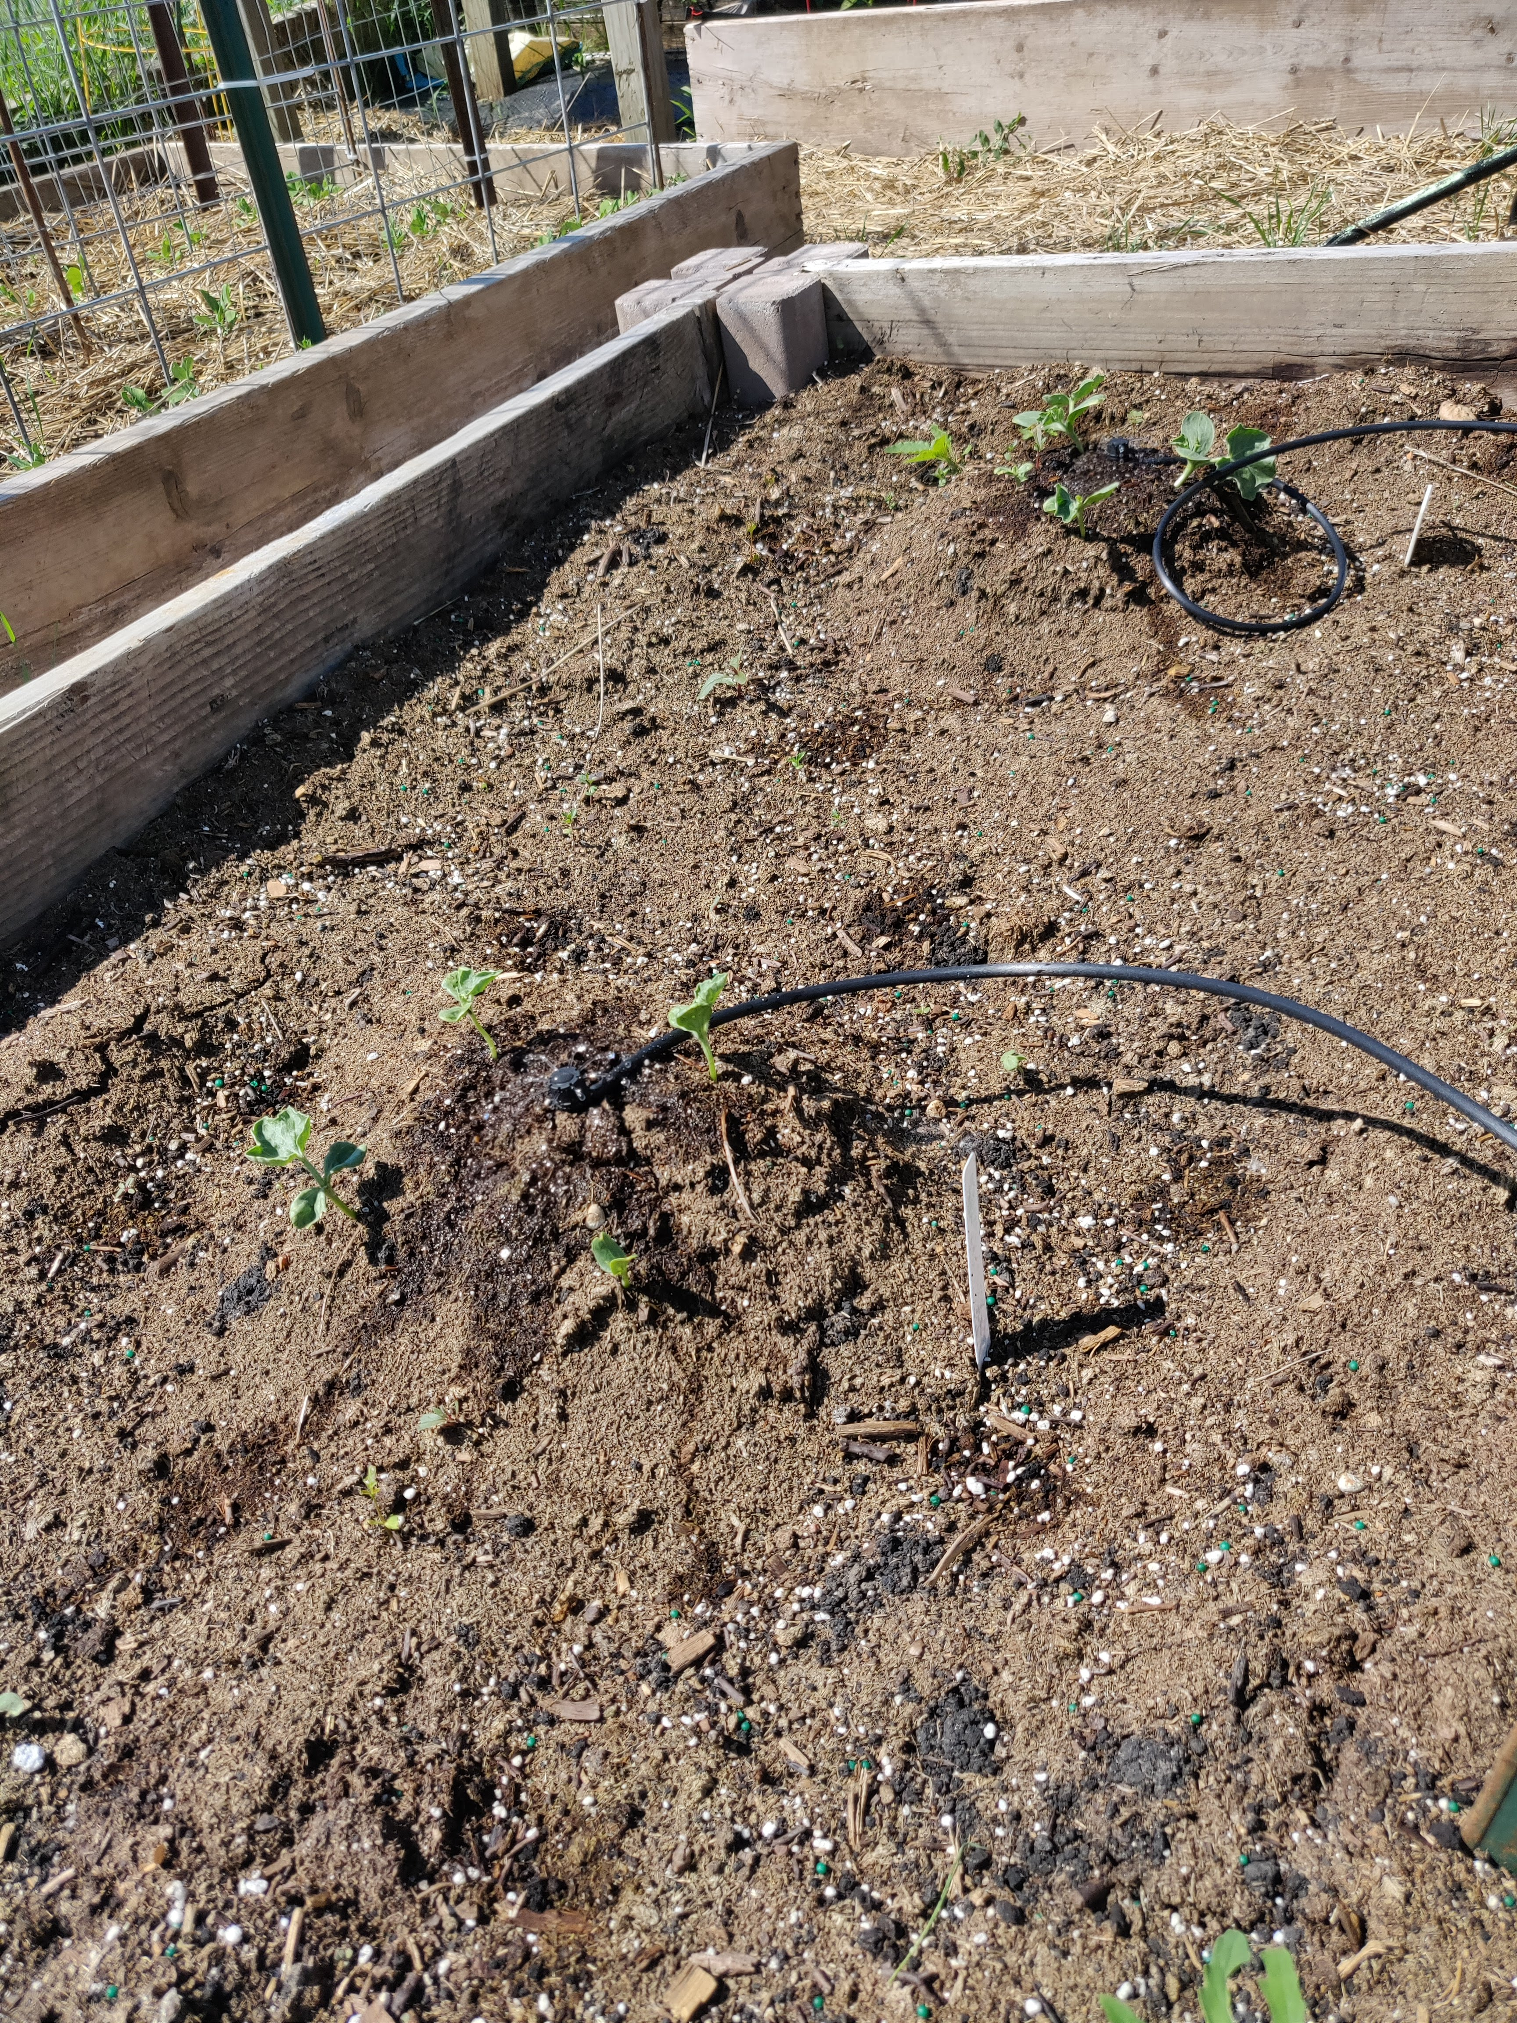
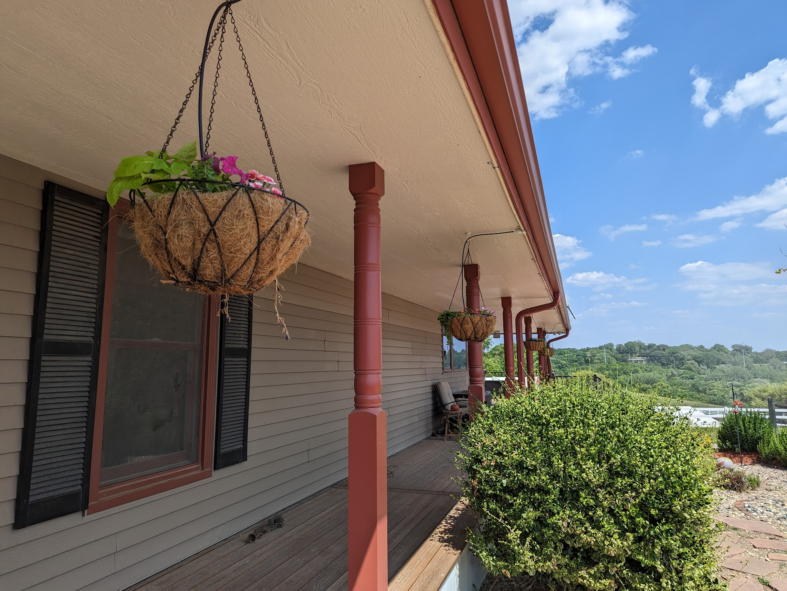

Slide 21
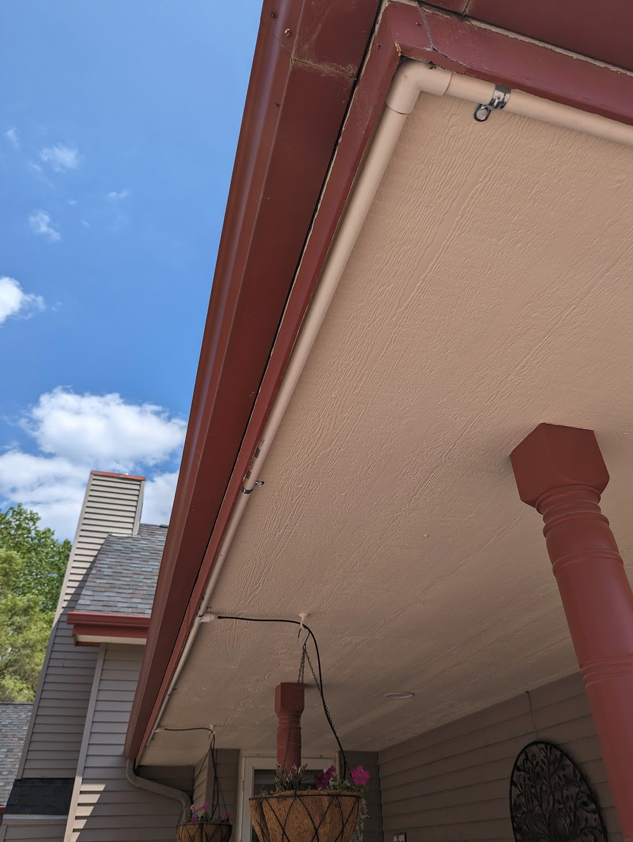
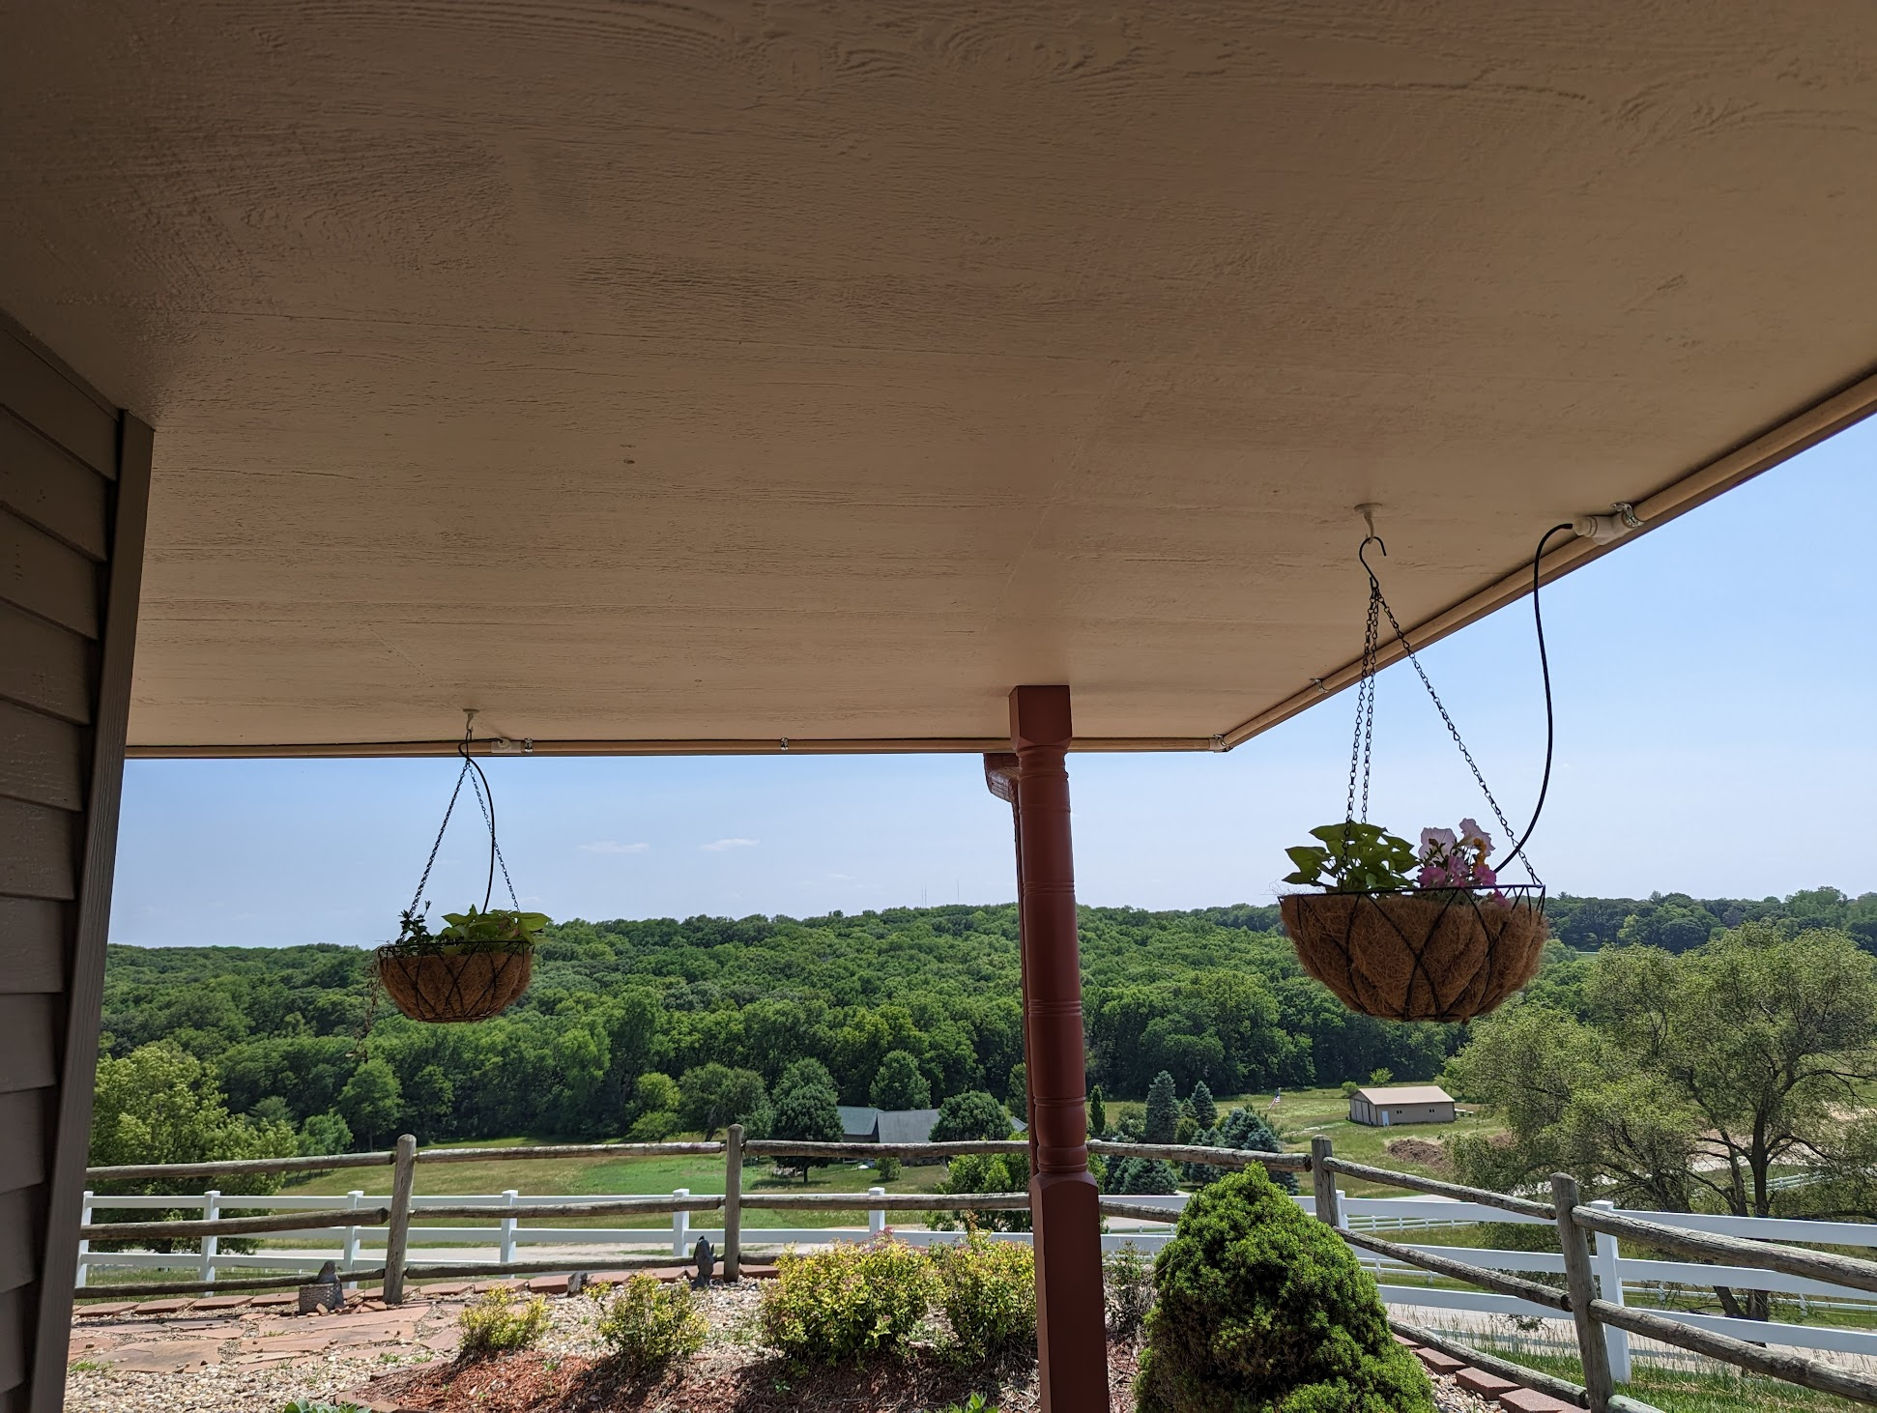
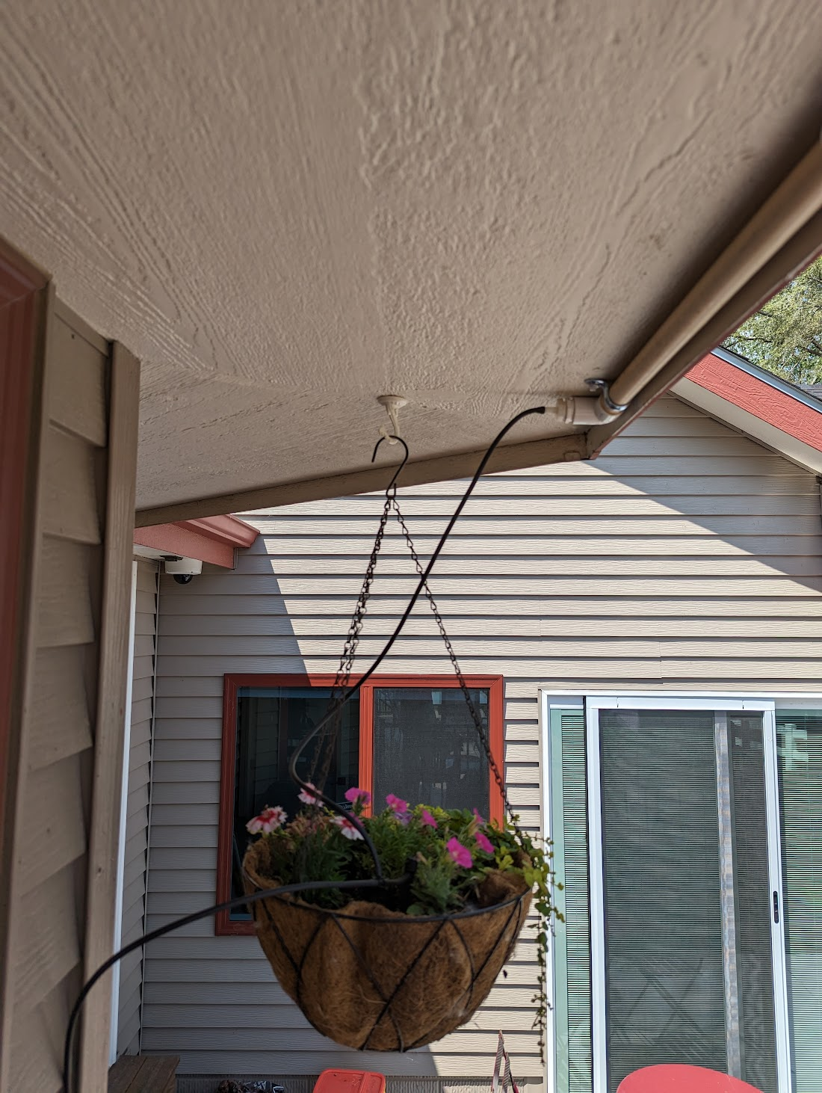

Slide 22
Thanks!
matt@hackspace.io
@themattvirus / @hackspaceio
www.hackspace.io
Please keep this slide for attribution

Slide 23
1/2" tubing: https://www.amazon.com/gp/product/B000WU5GGQ/
1/4" drip line: https://www.amazon.com/gp/product/B00EAIPKMG/
1/4" barbed fittings: https://www.amazon.com/gp/product/B0049C911O
1/4" regular line: https://www.amazon.com/gp/product/B0049PJMYC
1/2" tubing adapter: https://amzn.to/3P98qoY
Emitters: https://amzn.to/3JbeoBS
4-Relay Board:
https://usa.banggood.com/AC-or-DC-Power-Supply-ESP8266-WIFI-Four-way-Relay-Module-ESP-12F-Development-Board-Secondary-Development-p-1794113.html?cur_warehouse=CN
butane torch: https://amzn.to/43AUkAZ
wyze plug flash guide:
https://digiblur.com/2021/03/27/how-to-flash-the-wyze-outdoor-plug-esphome-or-tasmota-local-control/
wyze plug link: https://amzn.to/3VzOxHW
T-post sprinkler: https://www.lowes.com/pd/Yardsmith-T-Post-Sprinkler/1003050568

