Slide 1

TALES
FrOM THE CRYPT-omine
Matt Virus / @themattvirus

Slide 2

Matt Who?
  Yes, it’s my real name
  IoT Engineer at Cisco
  Crypto Enthusiast for 15+ years
  Former BTC CPU/GPU Miner –
    Long live BitMinter
  Kernelcon HHV – come visit us down the hall!

Slide 3
Unlocking the crypt
01
04
02
05
Cryptomining 101
profitability
Blocks, Miners, Hashing: Principles of Satoshi
Manipulating the curse of volatility
Hardware: CPU / GPU
Hacks, losses, & death
Democratic Access to Crypto
Exploits, Idiocy, and
De-listings
Algorithms + Software
Parting thoughts from the undead
03
06
Asic-resistance drives evolution
Miner Anatomy Lessons, Notes on Self-Custody

Slide 4

01
Crypto 101, LFG.
Blocks, Miners, Hashing: Principles of Satoshi
Your soul is on the blockchain ledger.
It’s listed right here

Slide 5

Blocks, Miners, hashing: Principles of Satoshi
October 31 2008 – Satoshi releases the Bitcoin Whitepaper
    Distributed / Decentralized
    Trustless – No 3rd Parties (banks..)
    No Double-Spend
      Public Ledger
      Timestamps
      Proof-of-Work
    Reward for Securing/Validating transactions
      Financial incentive to align rather than attack
    Rewards distributed to MINERS!

Slide 6
Blocks, Miners, hashing: Principles of Satoshi
    Blocks are containers of transaction data (e.g., “Alice sent Bob 5 coins”).
      Much like a page in bank teller’s ledger
    Each block includes:
      Data – list of transactions.
      Hash – unique identifier linking it to the previous block.
      Timestamp – marks when it was added.
    Blocks form a blockchain: a secure, linked sequence
    Blocks are found by miners solving difficult mathematical puzzles finding inputs to algorithmic hashes
      Blockchain arbitrarily specifies output, miners essentially brute-force the inputs
    Finding a block earns a reward

Slide 7

Blocks, Miners, hashing: Principles of Satoshi
    🛠️ Mining Process (Proof of Work)
      Miners compete to add new blocks to the blockchain
      Collect recent transactions
      Solve a complex cryptographic puzzle
    First miner to find block broadcasts the solution
    Network verifies and adds the block
    Rewards: new coins + transaction fees
    Ensures network security and prevents fraud
      Double-Spending
    Incentive is for all miners to mine on the same “chain”
      Preventing fragmentation → security/success

Slide 8

02
Hardware: CPU/GPU
Mine until it melts.

Slide 9
Hardware: CPU/GPU
    Solving cryptographic challenges requires vast compute power
    Different algorithms stress different components in hardware architecture
    Example key attributes
      Clockspeed
      Cache
      Memory speed/availability
      Core density/parallel thread capabilities
    Early mining was done with CPU, then optimized to GPU
    Specialized single-purpose mining hardware called ASICS came next

Slide 10
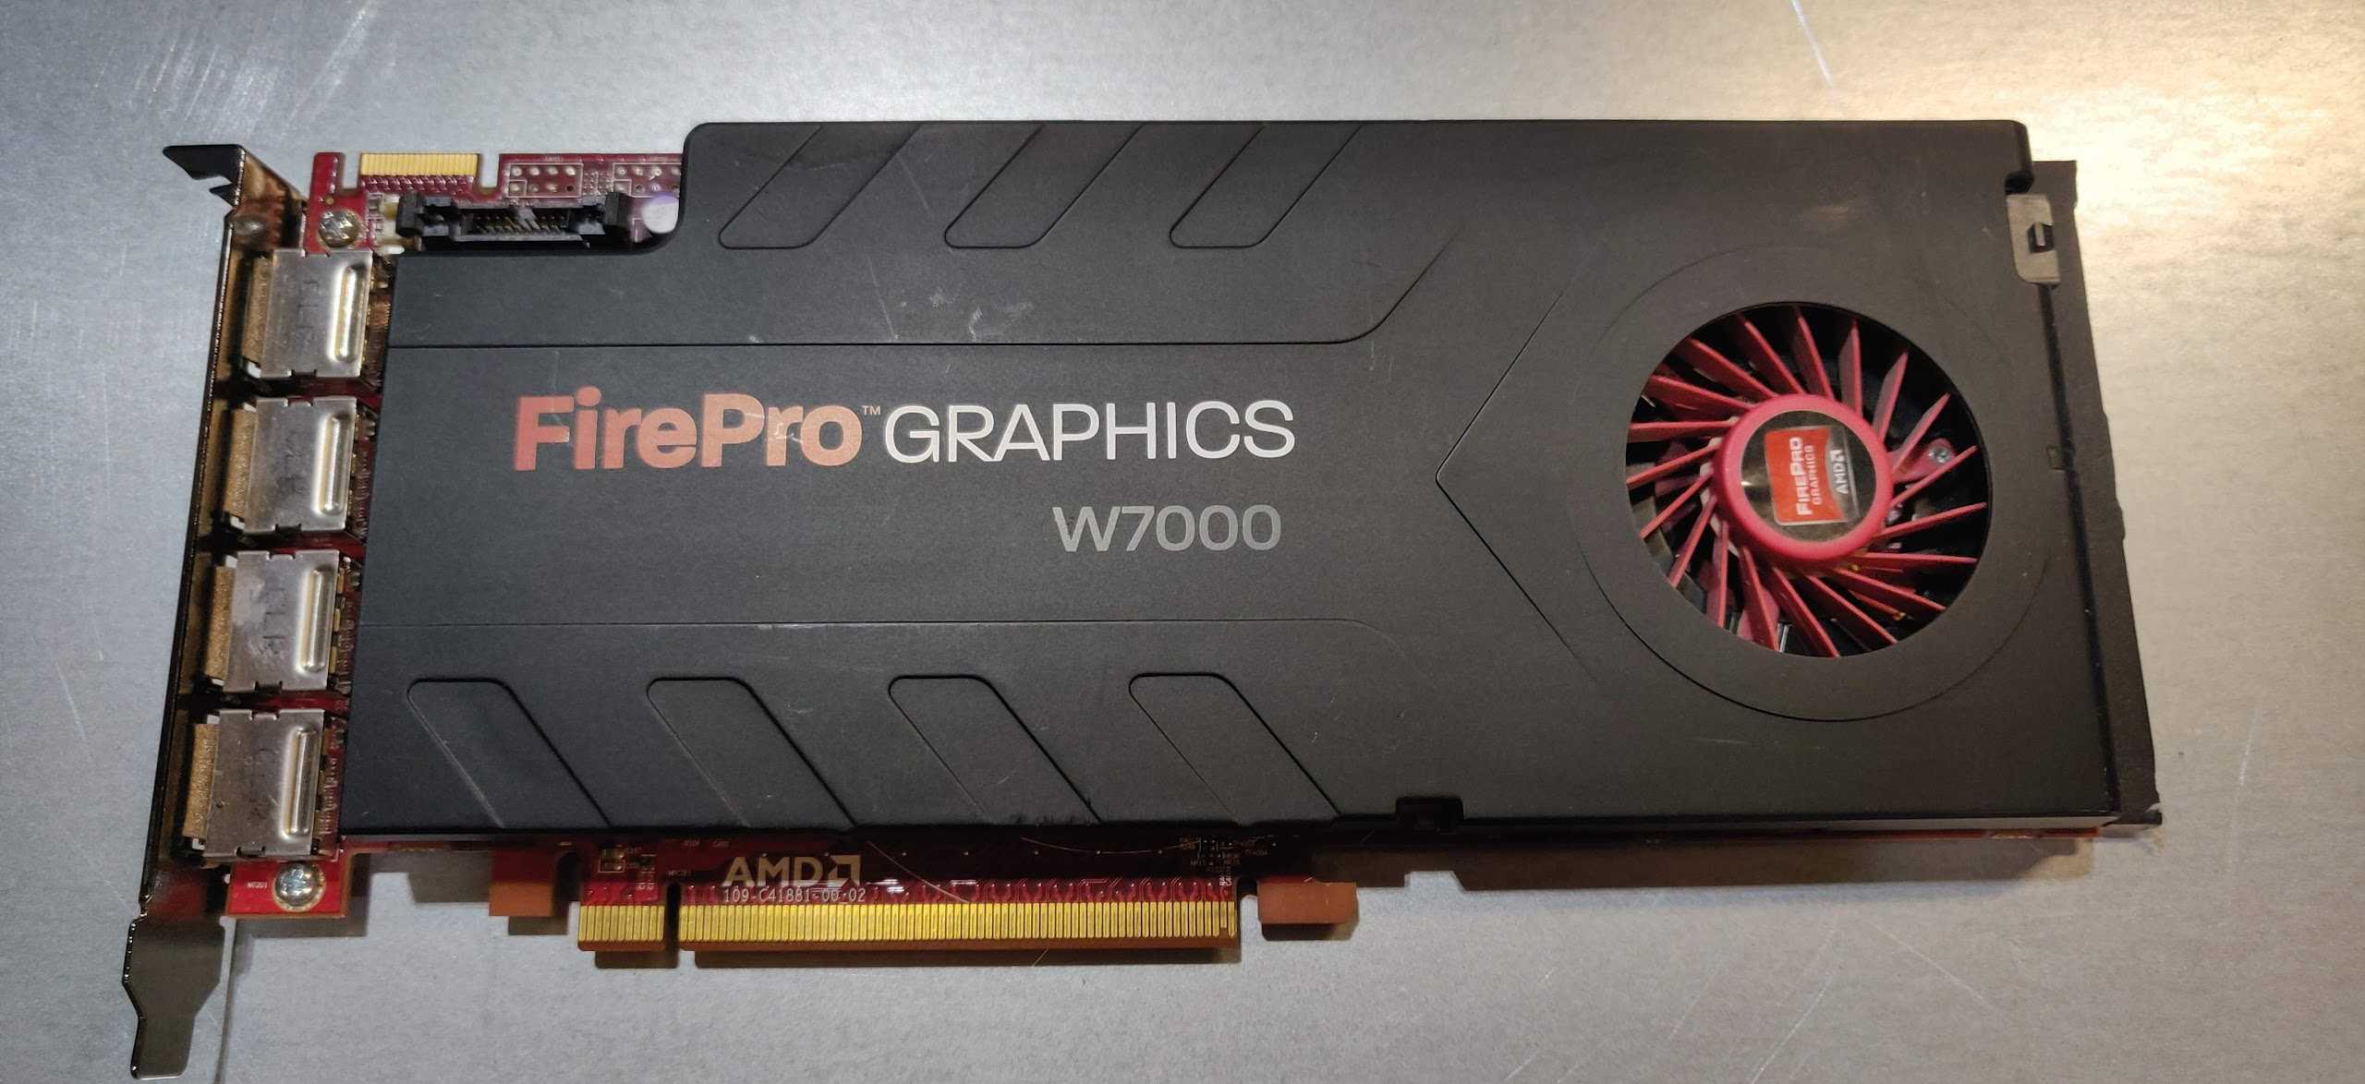
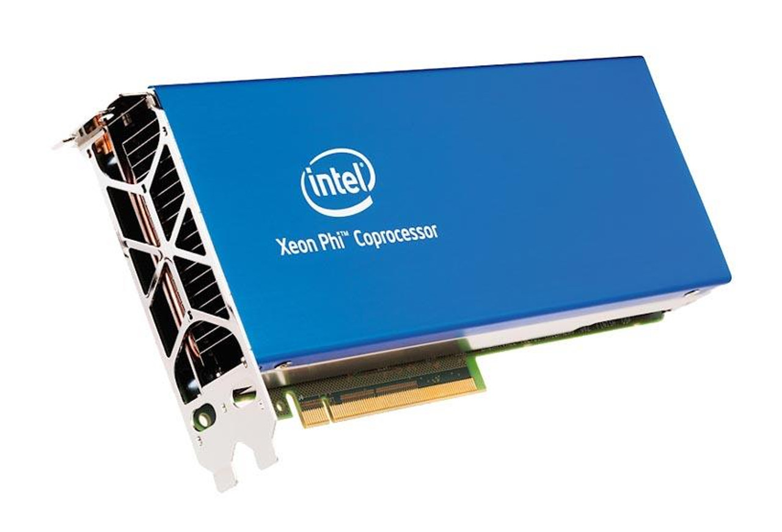
Hardware: CPU/GPU
    Mined with various AMD/Intel CPU’s
    Grid K1 – 1st “real” attempt with optimized hardware
    Cheap ATI + AMD cards
    40+ FirePro W7000, r7 r9, rx480/580/vega/etc
    Xeon Phi
      Intel “manycore” architecture
      PCI Card + socketed
      ~64 core / quad thread per core
      16GB 7200mhz cache on chip

Slide 11
Hardware: CPU/GPU
    Xeon Phi platform was the catalyst for mining
    Aligned with “privacy” coins launching after Bitcoin
      Monero
      Haven
      ZCash
    Challenges of Xeon Phi + GPU somewhat same
      Heat
      Optimization
    And somewhat different…
      GPU – silicon lottery
      Memory timings, clockspeeds, “straps”
      CPU – more predictable performance – set & forget

Slide 12

03
Algorithms & software
Segfault. Fatal Exception.

Slide 13
Algorithms and Software
    Many coins – many algorithms
      Cryptonight (monero, sumo, haven, electronium, etc)
      Keccac/Ethash (Ethereum)
      RandomX
      KawPow
      CN-GPU
      YesPower, etc
      …..
    Different mining software for different coins too
      XMR-Stak
      xmrig
      LOLminer
      Uselethminer
      SRBMiner
      Cpuminer-MULTI
      …
    Different software - all with different optimizations

Slide 14

04
Profitability
(dollar dollar bills yall)
Get that money

Slide 15
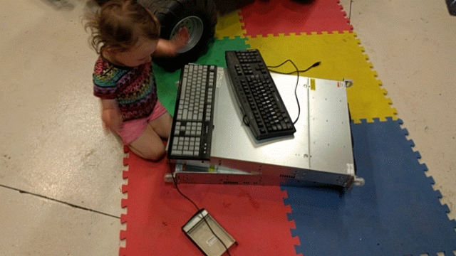
Profitability
    Use the best hardware to mine the most aligned coin
      Constant algorithm changes and forks
      Maintaining asic-resistance
      Review Markets
    Algorithm Switching Pools
      Monero Ocean
      ZergPool
      Come to the HHV – lab activity!
    Algorithm Switching Orchestration
      RainbowMiner
      Awesome Miner
    Diligence is key…
      Type as fast as you can

Slide 16
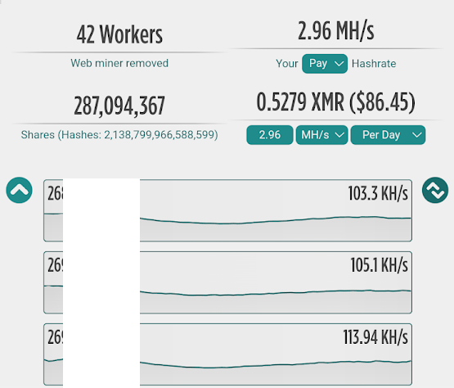
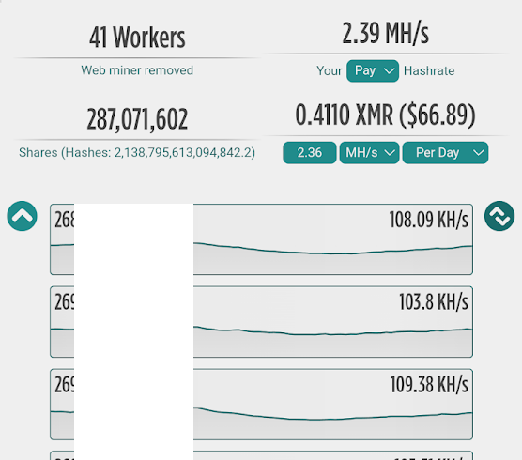
Profitability
    New coins launch → PUMP!
      Watch for favorable coins that align with your hardware
      “Clone” coins – same algorithm (RandomX, KawPow, etc, many coins)
      Auto-exchange them for coins you trust
    Algorithm Switching Pools
      Are always adding new coins
      Will solicit suggestions from trusted pool members
      Chase after desired coins and lobby
    This Instance – Salvium and Zephy Launch
      “new” → profits
      …capture without holding

Slide 17

05
Hacks, Losses, Death
Bad code and bad fundamentals never die…

Slide 18
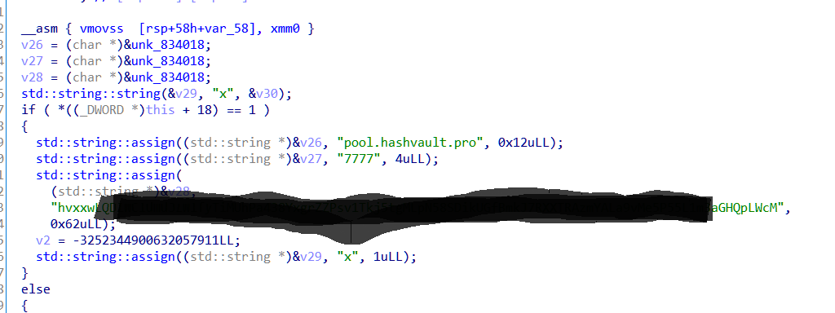
Hacks, Losses & Death
    Mining Software → “donation” shares
      Crypto software commonly mines a small amount of time to the developer wallet
      Example: 1 minute every hour, or 4% of all hashes,etc
      Hard-Coded mining pools
      Abandoned Miners → inflexible!
      Static requirements to dead pools or dead coins
      What to do….
    Decompile and examine
      Find donation address
      Verify no hashes/dead (be ethical-ish)
      Troll through code
    Identify interesting things!

Slide 19
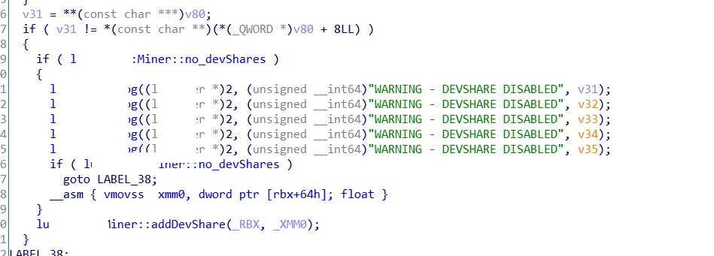
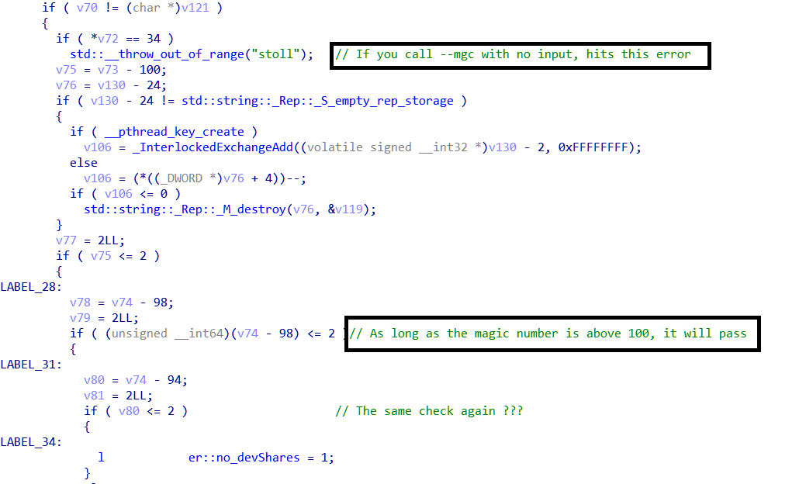
Hacks, Losses & Death
    What kind of interesting things?
      How to disable devshares completely
    Magic Number?
      Interesting validation/tampering handling
    Here we go…

Slide 20
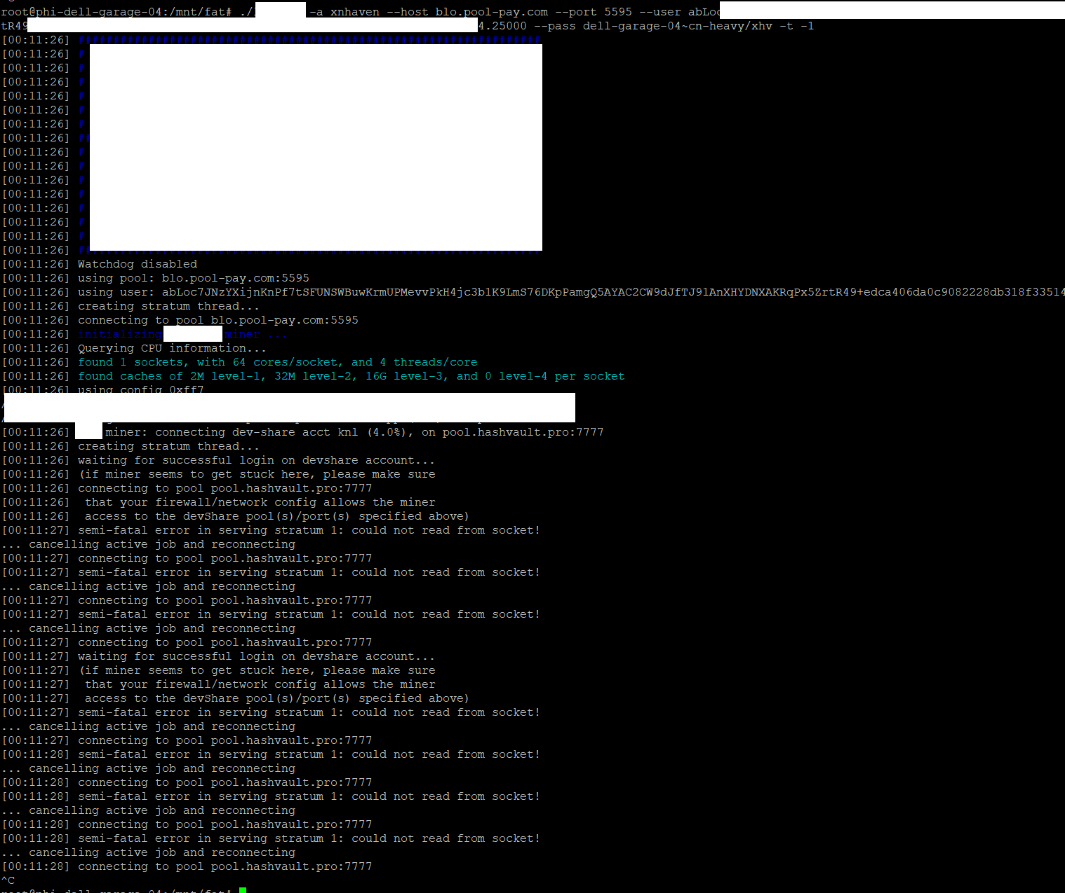
Hacks, Losses & Death
    BEFORE:

Slide 21
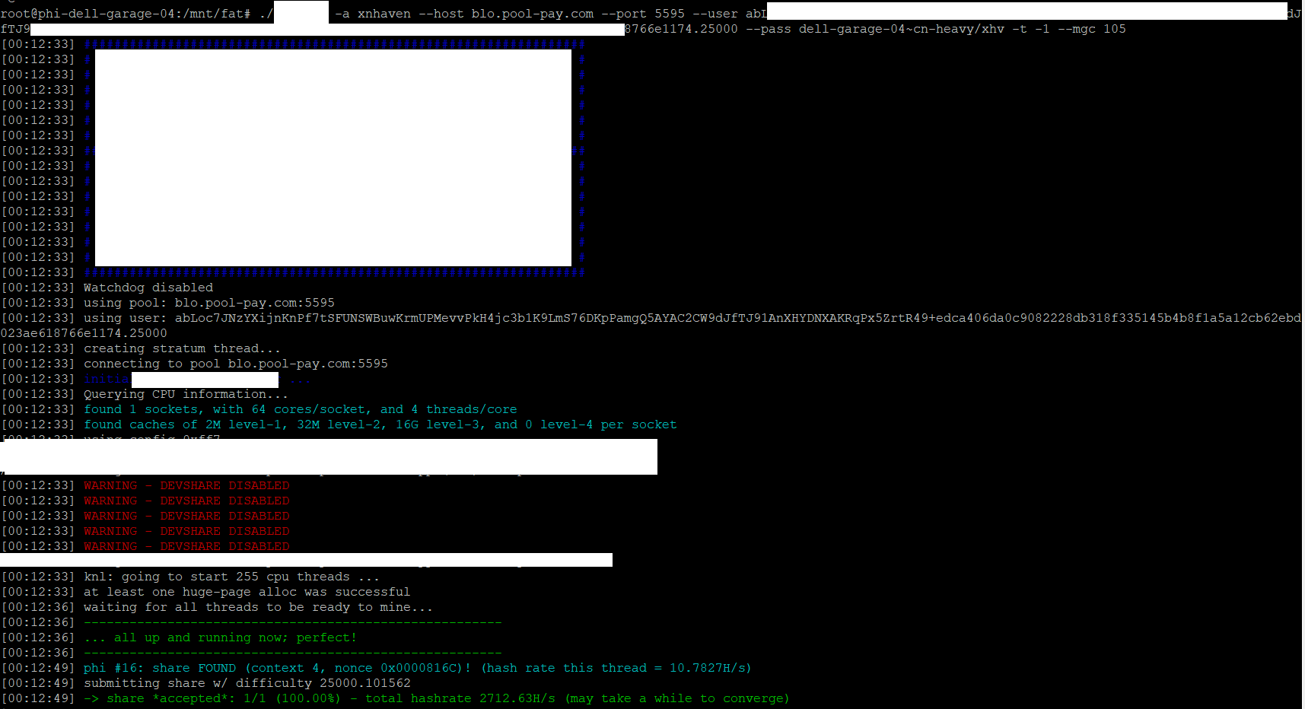
Hacks, Losses & Death
    After:

Slide 22
Hacks, Losses & Death
    Life after “magic number” discovery….
    All algorithms that this particular miner can use are wide open
    Clone coins, different pools, good to go.
      BLOC, OMBRE, etc.
    Same technique possible with all versions
      Different versions support different algorithms and hardfork variations
    Unfortunately, at present, not much profitability
      And now to the next slide to talk about Death…

Slide 23
Hacks, Losses & Death
    XMR/Monero moved from CryptoNight to RandomX
      Killed profits with Xeon Phi
    Haven coin used same core cryptonight algorithm with high scratchpad / high cache requirements
      Ideal alignment for Xeon Phi
    Haven – interesting “algorithmic stablecoin”
      xUSD stablecoin relationship
      xUSD could be converted back into an equivalent of $1 of XHV
    Scenario:
      1 Haven coin is worth $20
      1 Haven coin Is converted to 20 xUSD
      Haven market price doubles to $40
      20 xUSD converts back to Haven but is still worth $20US, which is now .5 XHV

Slide 24
Hacks, Losses & Death
    XHV ←→ xUSD : mint and burn
      Mint XHV, burn xUSD…vice versa
      “oracle” blockchain process monitors aggregate exchange value
      Lockup forces holding of xUSD for period of time to prevent arbitrage
    Exploit #1 – June 2021
      Multi-million dollars of XHV minted via exploit in oracle input validation
      Blockchain rolled back
    Exploit #2 – unknown
      Late 2024 via XHV/xUSD audit showed $millions of excess unaccounted for tokens
      XHV project halted. No recovery
    Spillover
      Salvium, Zephyr – both based on same code, show same exploit behavior
      https://x.com/demand_answer/status/1868950601817899154
      https://github.com/ZephyrProtocol/zephyr/commit/427277f7df11ead579f4f3a50ee9f0bee3d218db#diff-405e3149f1768290663dc4a6ac1df2beb0df7203d628b43879ffa9eadd8eab52

Slide 25

Hacks, Losses & Death
    Death of XHV forced innovation
      Yespower coins
      Deeper into rainbowminer
      Scripting to echo rainbowminer behavior on other hosts
    Mining old abandoned coins (BLOC.Money)
      Propped up by high price of BTC
      Market arbitrage exhausted – no buy orders at minimum cost ☹

Slide 26

06
Parting thoughts
(show and tell, pictures and wrap-up discusion)
The last hash before decomposition…

Slide 27
Parting Thoughts
    Anyone can mine
      More miners, more security
    Not your keys, not your coins
      Don’t keep your crypto on an exchange
      Use only trusted wallets
    Obscure hardware + investigation can be highly profitable
      Life….uh… finds a way?
      Be aware of the entire crypto ecosystem
    And now, some pictures

Slide 28
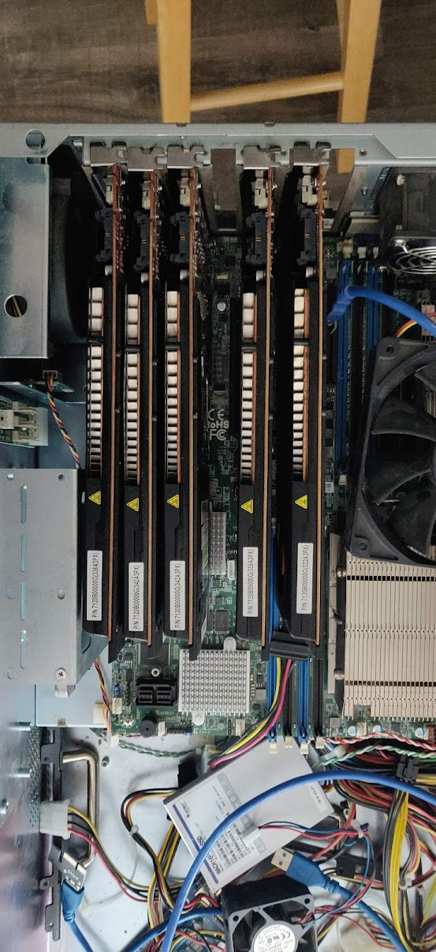
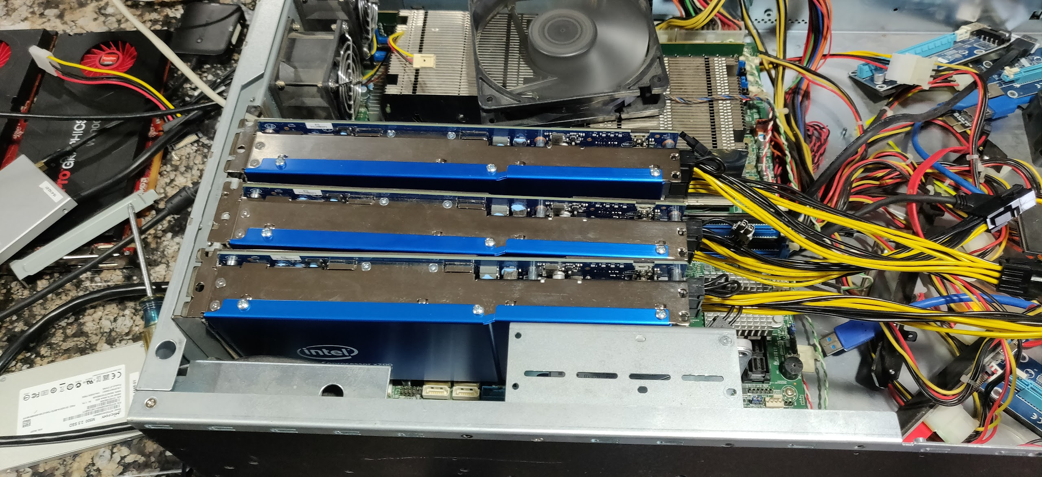
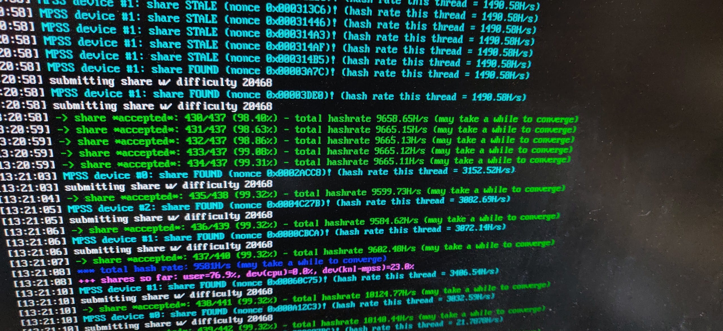
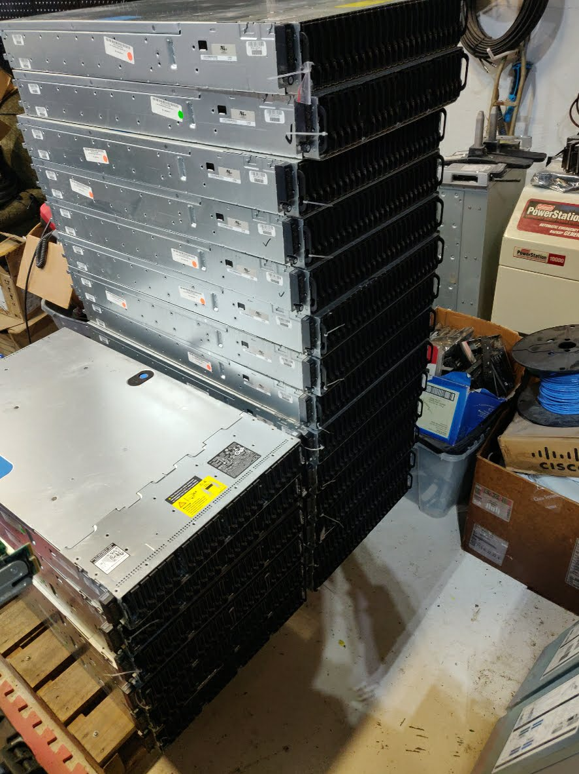
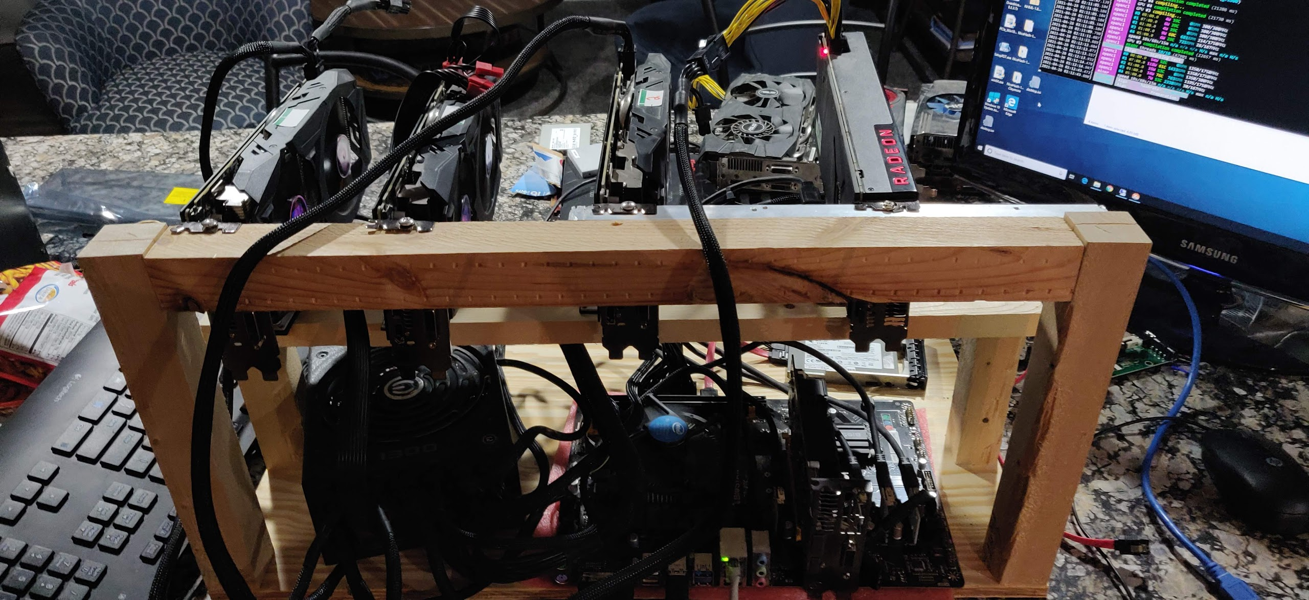

Slide 29
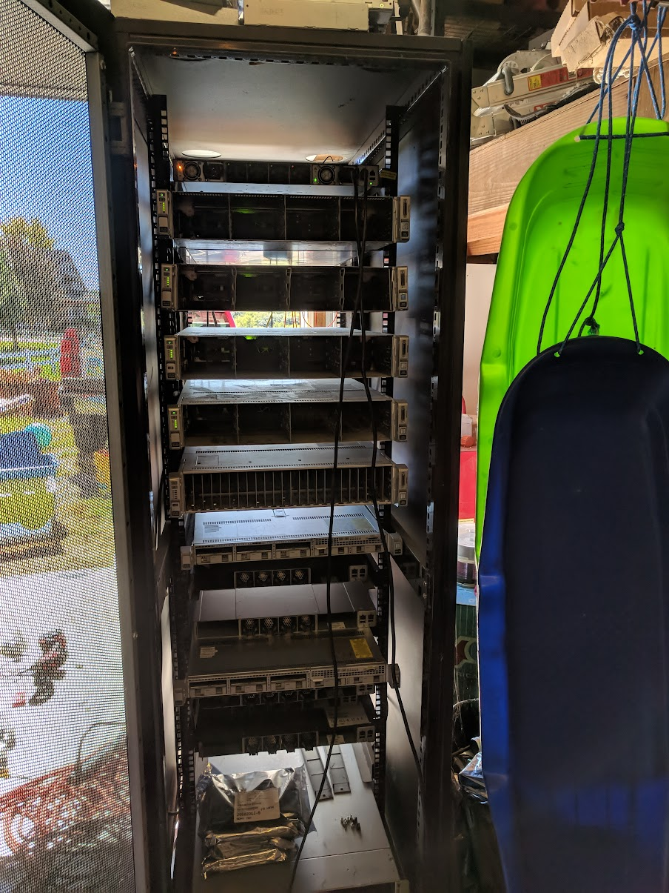
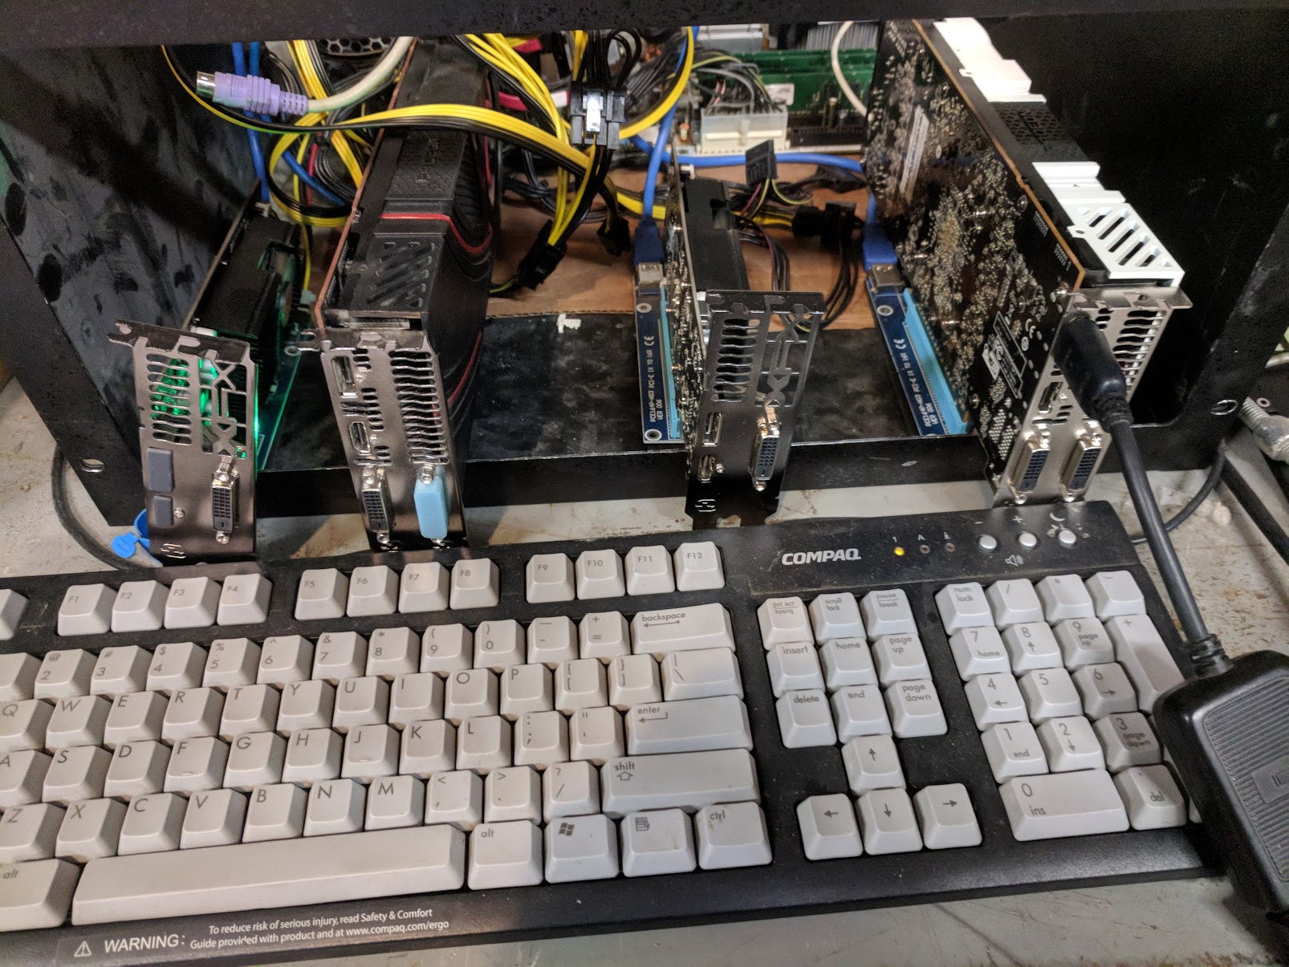

Slide 30

THANKS!
matt@hackspace.io
@themattvirus
Don’t forget to come to the HHV!
Please keep this slide for attribution

